Slide 1
Exact calculation of the magnetoelectric effect for S=1/2 XXZ-chain with Dzyaloshinskii-Moriya interaction.
Vadim Ohanyan
(Department of Theoretical Physics, Yerevan State University Yerevan, Armenia)
Tbilisi 15 March 2013

Slide 2

Outline
Michael Brockmann, Andreas Klümper, V.O. Phys. Rev. B 87, 054407 (2013).

Slide 3

Introduction
Exact description of the thermodynamics of the integrable spin chains
Magnetoelectric Effect
MEE denominates the mutual influence of the electric and magnetic properties in matter. In its most prominent form, MEE can be defined as the magnetic field dependence of (ferro)electric polarization and the electric field dependence of magnetization.
A.Klümper, M. Brockmann, and V. Ohanyan, Exact description of the
Magnetoelectric effect in the spin-1/2 XXZ-chain with Dzyaloshinskii-Moriya
interaction, arXiv:1210.7693 (2012).

Slide 4
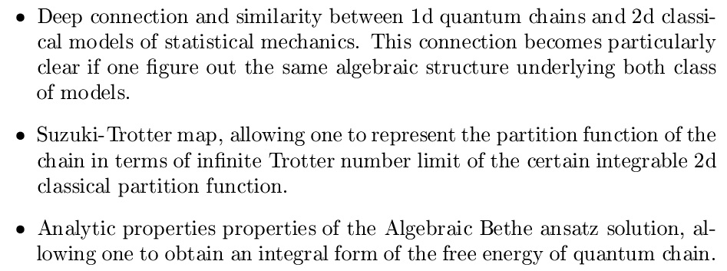

Slide 5
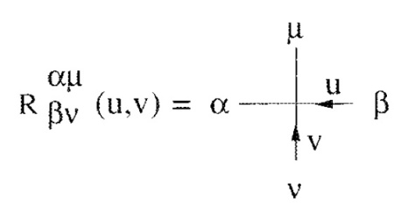




2d classical lattice models of statistical mechanics

Slide 6







Integrable quantum spinchains

Slide 7
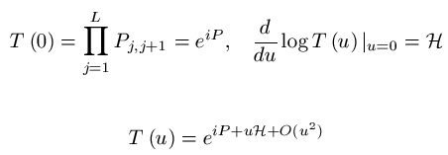
Similar algebraic structure of 2d classical model and integrable quantum chains
R-matrix of Boltzmann weights
Row-to-row transfer-matrix
RTT-relation
Commutativeity of the transfer-matrices
Lax operator
Monodromy matrix
RTT-relation
Commutative transfer-matrices
Conserved quantities

Slide 8

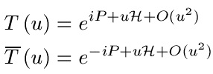
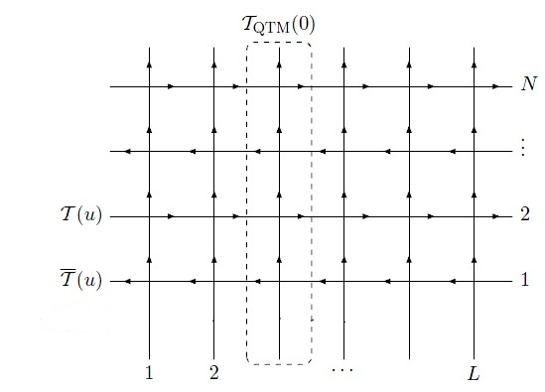

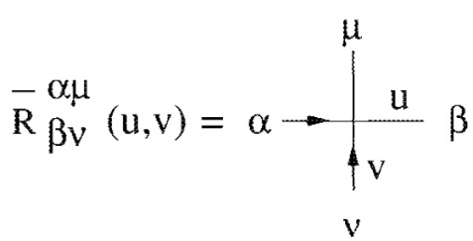

Quantum transfer-matrix

Slide 9

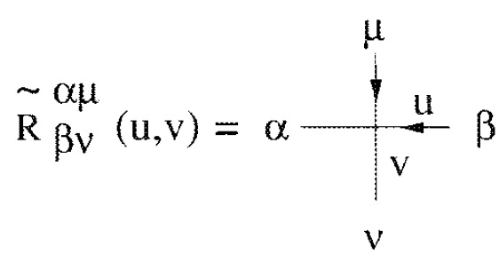


Quantum transfer-matrix

Slide 10




Slide 11

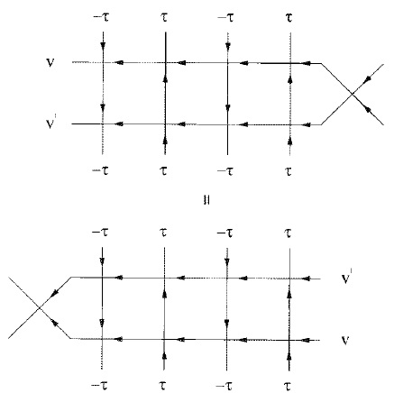


Slide 12

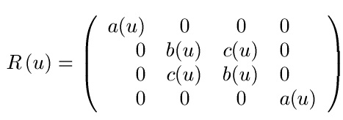
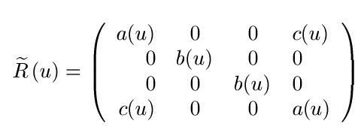


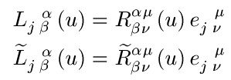

Slide 13





Slide 14
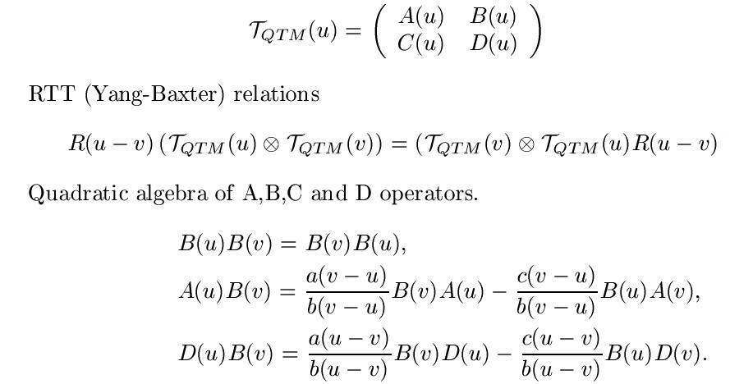



Slide 15
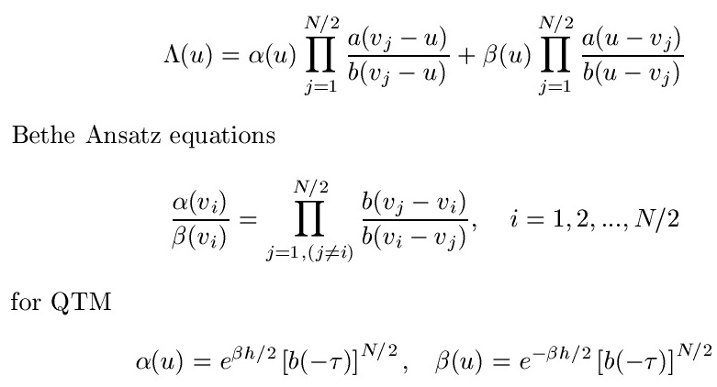


Slide 16




Slide 17
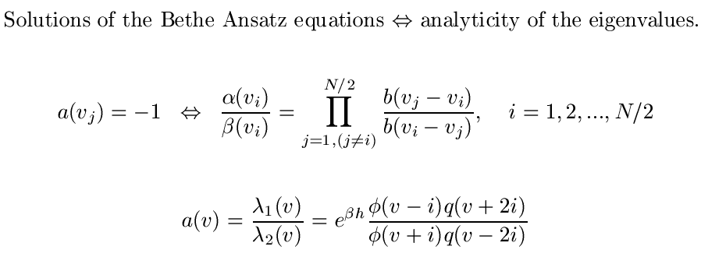



Slide 18
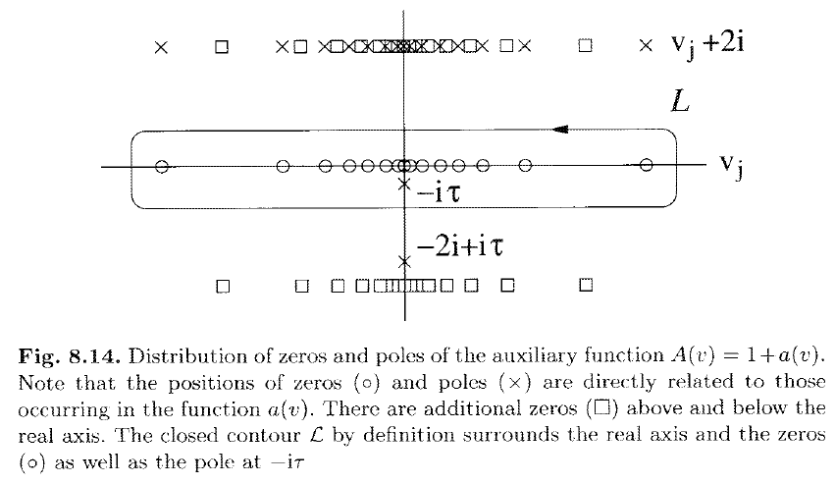




Slide 19




Slide 20





Slide 21



Slide 22



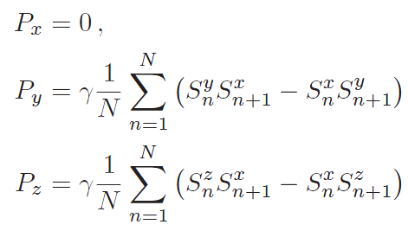


Slide 23
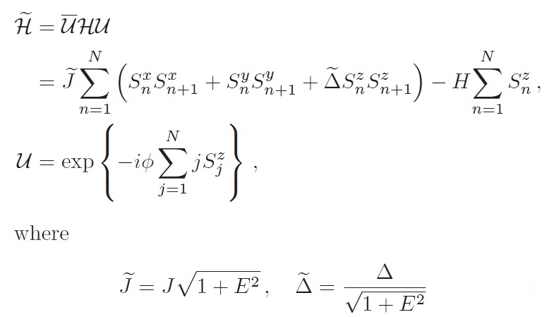
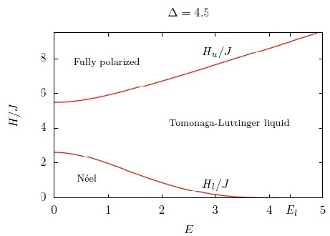
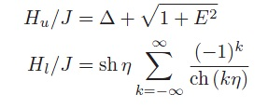


Slide 24
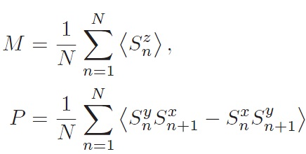
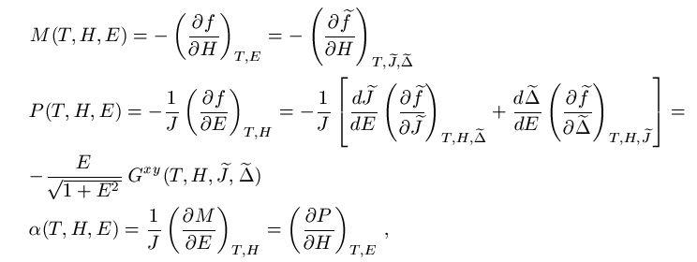

Slide 25




Slide 26
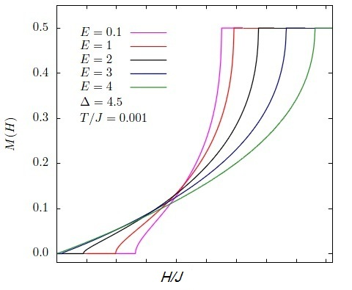
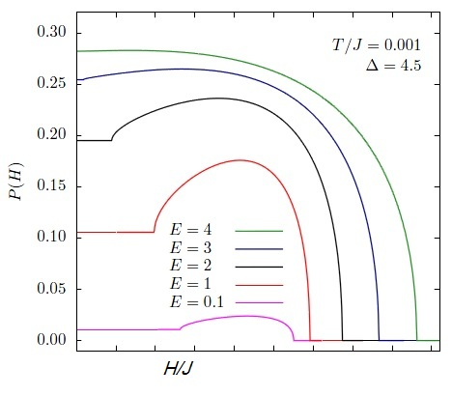
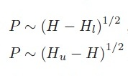


Slide 27
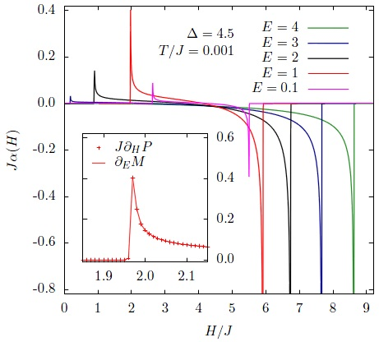
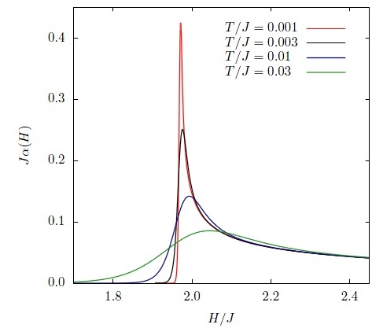

Slide 28
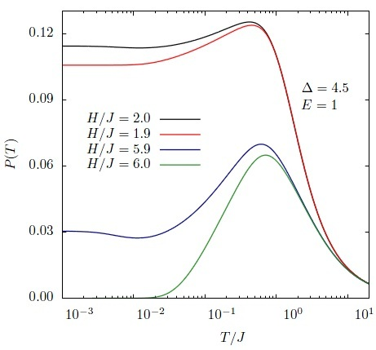
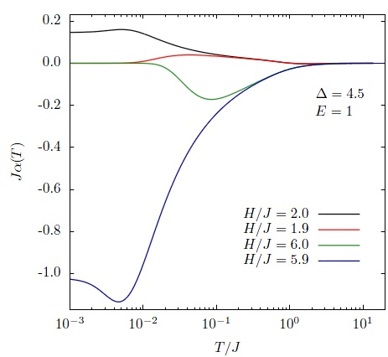

Slide 29
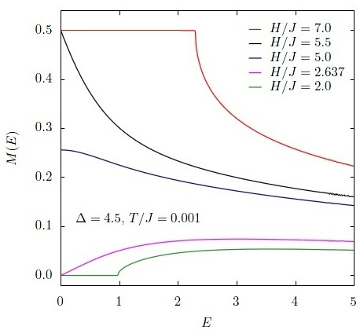
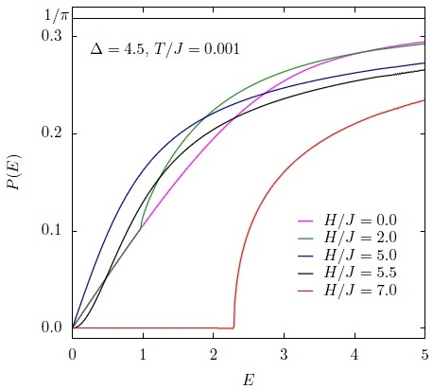


Slide 30
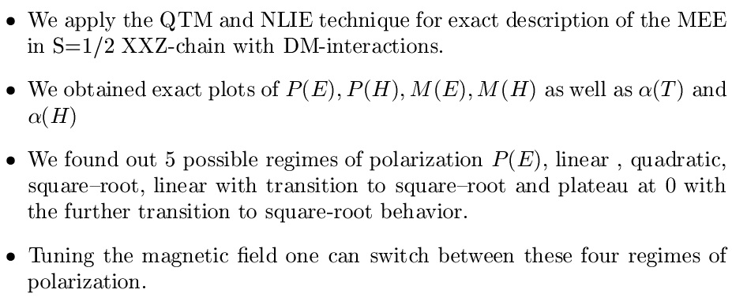
Summary and Conclusion

Slide 31
Thank you for attention !

