Slide 1

5D Standing Waves Braneworld
Merab GOGBERASHVILI
Associate Professor of
Javakhishvili Tbilisi State University

Slide 2

Main Interests
Gravity (extra dimensions, exact solutions of Einstein equations, alternative models of gravity)
Cosmology (dark matter, dark energy, baryon asymmetry)
Field Theory (quantum fields on curved backgrounds)
Mathematical Physics (exceptional algebras, octonions)
Current Teaching
Gravitation and Cosmology (Masters)
Elementary Particles (Masters)
Mechanics (Bachelors)
Current Research Topics
Thermodynamic gravity and its connection with quantum physics.
Applications of division algebras in physics.
Brane model with standing gravitational waves in the bulk.

Slide 3
Brane Models
Standing GW-s in 4D
GW-s from Brane
Localization Problem
Mechanical Waves
Optical Lattices
Boundary Conditions
Localization of Scalars
Localization of Vectors
Localization of Spinors
Plan
of the
talk

Slide 4
Brane models
Brane Models
Standing GW-s in 4D
GW-s from Brane
Localization Problem
Mechanical Waves
Optical Lattices
Boundary Conditions
Localization of Scalars
Localization of Vectors
Localization of Spinors
The scenario where our world is associated with a brane embedded in a higher dimensional space-time [1,2,3] has attracted a lot of interest with the aim of solving several open questions in modern physics.
Most of brane models were realized as time independent field configurations. Here we present the braneworld scenario with non-stationary metric coefficients proposed in [4]. The braneworld is generated by 5D standing gravitational waves coupled to a phantom-like scalar field in the bulk.
The nodes of standing waves correspond to Anti-de-Sitter ‘islands’ having the different 4-dimensional cosmological and gravitational constants,
Λ_{n} = e^{2aξ(n)} Λ₅ , G_{n} = e^{-2aξ(n)} G₅ /2d ,
and could be used to solve the hierarchy and cosmological constant problems.
[1] N. Arkani-Hamed, S. Dimopoulos and G. Dvali, Phys Lett. B 429 (1998) 263.
[2] M. Gogberashvili, Int. J. Mod. Phys. D 11 (2002) 1635, [hep-ph/9812296].
[3] L. Randall and R. Sundrum, Phys. Rev. Lett. 83 (1999) 3370; 4690.
[4] M. Gogberashvili and D. Singleton, Mod. Phys. Lett. A 25 (2010) 2131.
Page – 4/13

Slide 5
Standing GW-s in 4D
Brane Models
Standing GW-s in 4D
GW-s from Brane
Localization Problem
Mechanical Waves
Optical Lattices
Boundary Conditions
Localization of Scalars
Localization of Vectors
Localization of Spinors
For the massless scalar field, which obeys the Klein-Gordon equation,
(- g)^{-1/2}∂_{α} [(- g)^{1/2} g^{αβ} ∂_{β}φ] = 0 ,
the Einstein equations can be written as:
R_{αβ} = 2 ∂_{α}φ ∂_{β}φ .
We take the metric ansatz [1],
ds² = (1 + kz)^{-1/2} e^{-S(t,z)} (dt² - dz²) – (1 + kz) (e^{u(t,z)} dx² + e^{-u(t,z)} dy²) ,
which is the combination of the domain wall solution (S(t,z) = u(t,z) = 0) [2] and the plane wave solutions (k = 0) [3]. In our case the solution has the form:
φ(t,z) = A/2 sin(ωt) J₀(ωz + ω/k) , u(t,z) = A cos(ωt) J₀(ωz + ω/k) ,
S(t,z) = A ω²/4k² (1 + kz)² (J₀² + 2J₁² - J₀J₂) ,
where J_{n}(ωz+ω/k) are Bessel functions, A is the gravitational wave amplitude and ω = kξ_{n} is its discrete frequency (ξ_{n} are the zeros of J₀). Time oscillations of u(t,z) and φ(t,z) are π/2 out of phase, i.e. the energy of the oscillations passing back and forth between the scalar and gravitational waves, as in [4].
[1] M. Gogberashvili, S. Myrzakul and D. Singleton, Phys. Rev. D 80 (2009) 024040.
[2] A. Vilenkin, Phys. Rev. D 23 (1981) 852.
[3] J. Griffiths, Colliding Plane Waves in General Relativity (Oxford Un. Press, 1991).
[4] M. Gogberashvili and R. Khomeriki, Mod. Phys. Lett. A 24 (2009) 2761.
Page – 5/13

Slide 6
GW-s from Brane
Brane Models
Standing GW-s in 4D
GW-s from Brane
Localization Problem
Mechanical Waves
Optical Lattices
Boundary Conditions
Localization of Scalars
Localization of Vectors
Localization of Spinors
In the case of (1+4)-space with bulk phantom-like massless scalar field, σ(t,r), the 5D Einstein equations,
R_{ab} = - ∂_{a}σ ∂_{b}σ + 3/2 g_{ab}Λ₅ ,
have the standing wave solution [1],
ds² = e^{2a|r|}(dt² - e^{u}dx² - e^{u}dy² - e^{-2u}dz²) - dr² ,
u(t,r) = A sin(ωt) e^{-2ar} Y₂(ωe^{-ar}/a) ,
where a = (3Λ₅/8)^{1/2} is the curvature scale, A is a constant and Y₂(r) is the 2nd order Bessel function of the second kind.
Standing waves can provide a new universal localization mechanism. Indeed, as it is clear from the equations of motion of spinless particles in the quadrupole approximation [2],
DP^{ν}/ds = F^{ν} = - J^{αβγδ} D^{ν} R_{αβγδ}/6 ,
where P^{ν} is the total momentum and J^{αβγδ} is the quadrupole moment, the quadrupole force F^{ν} will eject particles out of the regions with high curvature.
[1] M. Gogberashvili and D. Singleton, Mod. Phys. Lett. A 25 (2010) 2131.
[2] W.G. Dixon, Nuovo Cim. 34 (1964) 318; Gen. Rel. Grav. 4 (1973) 199.
Page – 6/13

Slide 7
Localization Problem
Brane Models
Standing GW-s in 4D
GW-s from Brane
Localization Problem
Mechanical Waves
Optical Lattices
Boundary Conditions
Localization of Scalars
Localization of Vectors
Localization of Spinors
A key requirement for theories with extra dimensions is that the various bulk fields be localized on the brane. It is especially economical to consider models with a pure gravitational localization mechanism, since gravity has the unique feature of having a universal coupling with all matter fields. To have localized fields on a brane ‘coupling’ constants appearing after integration of their Lagrangians over the extra coordinates must be non-vanishing and finite.
In (1+4)-dimensional models spin-0 and spin-2 field are localized on the brane with decreasing and spin-1/2 field with increasing warp factors [1]; spin-1 field is not normalizable at all [2].
For (1+5)-dimensions spin 0, 1 and 2 fields are localized on the brane with decreasing warp factor and the spin-1/2 field with increasing warp factor [3].
So to fulfill the localization of Standard Model particles in (1+4)- or (1+5)-spaces it was required to introduce other interaction but gravity. The possibility of pure gravitational trapping of zero modes of all bulk fields, but using artificial matter sources, was demonstrated for the brane solutions with an increasing warp factor in [4].
[1] B. Bajc and G. Gabadadze, Phys. Lett. B 474 (2000) 282.
[2] A. Pomarol, Phys. Lett. B 486 (2000) 153.
[3] I. Oda, Phys. Rev. D 62 (2000) 126009.
[4] M. Gogberashvili and D. Singleton, Phys. Rev. D 69 (2004) 026004;
M. Gogberashvili and P. Midodashvili, Phys. Lett. B 515 (2001) 447.
Page – 7/13

Slide 8
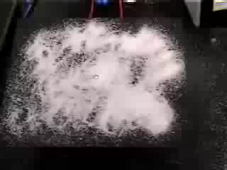
Mechanical Waves
Brane Models
Standing GW-s in 4D
GW-s from Brane
Localization Problem
Mechanical Waves
Optical Lattices
Boundary Conditions
Localization of Scalars
Localization of Vectors
Localization of Spinors
Sand on a rectangular plate shows the resonance patterns at specific frequencies of oscillation: ω >> m c²/ħ .

Slide 9
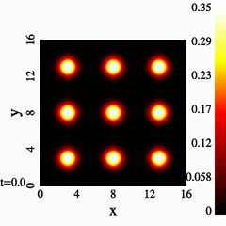
Optical Lattices
Brane Models
Standing GW-s in 4D
GW-s from Brane
Localization Problem
Mechanical Waves
Optical Lattices
Boundary Conditions
Localization of Scalars
Localization of Vectors
Localization of Spinors
Standing electromagnetic waves, optical lattices, can provide trapping of particles (Nobel Prize in 1997) by scattering, dipole [1] and quadrupole forces [2].
[1] H.J. Metcalf and P. van der Straten, Laser Cooling and Trapping (Springer, New York 1999).
[2] N. Moiseyev, M. Šindelka and L.S. Cederbaum, Phys. Rev. A 74 (2006) 053420.
Page – 9/13

Slide 10
Boundary conditions
Brane Models
Standing GW-s in 4D
GW-s from Brane
Localization Problem
Mechanical Waves
Optical Lattices
Boundary Conditions
Localization of Scalars
Localization of Vectors
Localization of Spinors
The ghost-like field σ(t,r), along with the metric oscillations u(t,r), must be unobservable on the brane. This condition quantizes the oscillation frequency of the standing wave in terms of the curvature scale:
ω / a = X_{n} ,
where X_{n} is the n-th zero of the Bessel function Y₂(r). Correspondingly, the functions σ(t,r) and u(t,r) vanish at the number of points along the extra dimension. These points - the nodes of standing wave - can be considered as 4D space-time ‘islands’, where the matter particles are assumed to be bound. Brane is placed at r = 0, in one of the nodes of standing waves.
In equations of matter the oscillatory function u(t,r) enters via exponentials:
e^{bu} = Σ (bu)^{n} / n! .
To localize matter fields we suppose that the frequency of standing waves is much larger than frequencies associated with the particles on the brane. In this case we can perform time averaging of oscillating exponents in the equation for matter fields. For the time averages of oscillating exponents we find [1,2]:
<e^{bu} > = I₀﴾ |bA| e^{-2a|r|}Y₂(e^{a|r|}ω/a)﴿ ,
where I₀(r) is the modified Bessel function of the zero order.
[1] M. Gogberashvili, P.Midodashvili, L.Midodashvili, Phys. Lett. B 702 (2011) 276 [2] M. Gogberashvili, A. Herrera, D. Malagon, Clas. Quant. Grav. 29 (2012) 025007.
Page – 10/13

Slide 11
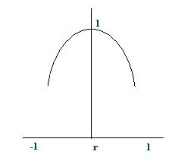
Localization of Scalars
Brane Models
Standing GW-s in 4D
GW-s from Brane
Localization Problem
Mechanical Waves
Optical Lattices
Boundary Conditions
Localization of Scalars
Localization of Vectors
Localization of Spinors
The action of 5D massless scalar field has the form:
S = - ∫d⁴xdr (g)^{1/2} g^{AB}∂_{A}Φ∂_{B}Φ ,
with the determinant (g)^{-1/2} = e^{4a|r|}. Separating variables,
Φ(x^{A}) = exp(ip_{α}x^{α}) ρ(r) ,
and time averaging the Klein-Gordon equation we find behavior of extra dimension part of the zero mode ρ(r) far from and close to the brane [1,2]:
ρ(r)| _{r→±∞} ~ e^{-4a|r|} ,
ρ(r)| _{r→±0} ~ const .
So ρ(r) has maximum at r = 0, falls off from the brane, and vanishes at the infinity as e^{-4a|r|}. In S the determinant and the metric
[1] M. Gogberashvili, JHEP 2012 (2012) 56;
[2] M.Gogberashvili, P.Midodashvili, L.Midodashvili, Phys. Lett. B 702 (2011) 276.
tensor with upper indices give the increasing factor e^{2a|r|}. This is the reason why in the original brane models the scalar field zero modes (with the constant extra part) can be localized on the brane only for a < 0. In our model ρ(r) is not a constant, moreover, for a > 0 it contains the exponentially decreasing factor leading to the convergence of the action integral S by r.
Shape of ρ(r) close to the brane
Page – 11/13

Slide 12
Localization of Vectors
Brane Models
Standing GW-s in 4D
GW-s from Brane
Localization Problem
Mechanical Waves
Optical Lattices
Boundary Conditions
Localization of Scalars
Localization of Vectors
Localization of Spinors
The action of the 5D Abelian vector field has the form:
S = - ∫d⁴xdr (g)^{1/2} g^{AB}g^{CD}F_{AC}F_{BD} ,
were F_{AB} = ∂_{A}A_{B} - ∂_{B}A_{A}. We seek for solution in the form:
A_{t}(x^{C}) = ρ(r) a_{t}(x^{α}) , A_{x}(x^{C}) = e^{u(t,r)}ρ(r) a_{x}(x^{α}) , A_{y}(x^{C}) = e^{u(t,r)}ρ(r) a_{y}(x^{α}) ,
A_{z}(x^{C}) = e^{-2u(t,r)}ρ(r) a_{z}(x^{α}) , A_{r}(x^{C}) =0 ,
where u(t, r) is the oscillatory metric function and
a_{β} (x^{α}) ~ ε_{β} exp(ip_{α}x^{α})
denote the components of the 4D vector potential on the brane. Time averaging the Maxwell equations we find behavior of the extra dimension part of vector zero mode ρ(r) far from and close to the brane [1,2]:
ρ(r)| _{r→±∞} ~ e^{-2a|r|} , ρ(r)| _{r→±0} ~ const .
So ρ(r) has maximum at r = 0, falls off from the brane and vanishes at the infinity as e^{-2a|r|}. In S the extra dimension parts of the determinant and two metric tensors with upper indices cancel each other. Because of this in the original brane models the vector field zero modes (with the constant extra part) cannot be localized on the brane for any sign of a. In our model ρ(r) is not a constant, for a > 0 it contains the exponentially decreasing factor and integral of S by r is convergent.
[1] M. Gogberashvili, JHEP 2012 (2012) 56;
[2] M.Gogberashvili, P.Midodashvili, L.Midodashvili, Phys. Lett. B 707 (2012) 169
[1] M.Gogberashvili, P.Midodashvili, L.Midodashvili, Phys. Lett. B 702 (2011) 276.
Page – 12/13

Slide 13
Localization of Spinors
Brane Models
Standing GW-s in 4D
GW-s from Brane
Localization Problem
Mechanical Waves
Optical Lattices
Boundary Conditions
Localization of Scalars
Localization of Vectors
Localization of Spinors
The action of the massless 5D spinor field has the form:
S = - ∫d⁴xdr (g)^{1/2} iΨΓ^{A}D_{A}Ψ .
We perform the chiral decomposition for the bulk fermion field wave function:
Ψ (x^{C}) = ψ_{L}(x^{α}) λ(r) + ψ_{R}(x^{α}) ρ(r) .
Here λ(r) and ρ(r) are extra dimension factors of left and right fermions and
ψ_{L}(x^{α}) ~ ε_{L} exp(ip_{α}x^{α}) ,
ψ_{R}(x^{α}) ~ ε_{R} exp(ip_{α}x^{α}) ,
We find behavior of extra dimension parts of the left and right fermionic zero modes far from and close to the brane [1,2]:
λ(r)| _{r=±0} = C , λ(r)| _{r→±∞} ~ e^{-3a|r|} ,
ρ(r)| _{r=±0} = 0 , ρ(r)| _{r→±∞} ~ e^{-2a|r|} .
The extra dimension part of the left spinor λ(r) has maximum on the brane and decreases as ~ e^{-3a|r|} at the infinity, so left zero modes are localized on the brane. At the same time right fermions are absent on the brane - ρ(0) = 0. Also in the action S the determinant increases as e^{4a|r|} and integral over r diverges. So zero modes of right fermions are not normalizable.
[1] M. Gogberashvili, JHEP 2012 (2012) 56;
[2] M. Gogberashvili, P. Midodashvili, L. Midodashvili, Int. J. Mod. Phys. D 21 (2012) 1250081.
[1] M.Gogberashvili, P.Midodashvili, L.Midodashvili, Phys. Lett. B 702 (2011) 276.
Page – 13/13

Slide 14
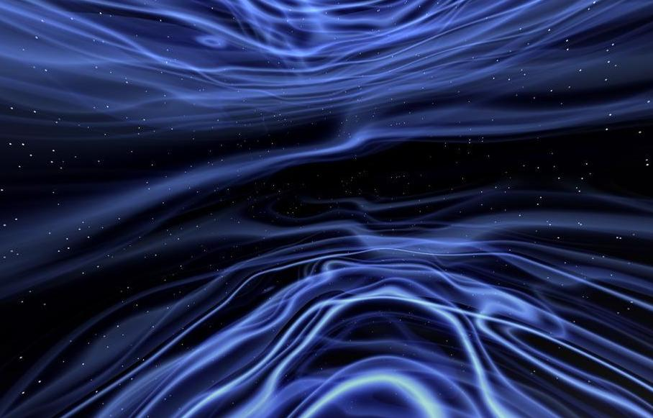
Conclusions
Within the 5D standing wave braneworld model we have investigated the pure gravitational localization mechanism. For the increasing warp factor we have shown existence of the normalizable zero modes of spin-0, -1 and -2 fields on the brane. For the case of spin-½ fields we find that only left spinor field zero modes are localized on the brane, while right fermionic wave functions are localized in the bulk.
References:
Phys. Rev. D 80 (2009) 024040;
Mod. Phys. Lett. A 25 (2010) 2131;
Phys. Lett. B 702 (2011) 276;
Phys. Lett. B 707 (2012) 169 ;
Clas. Quant. Grav. 29 (2012) 025007;
Int. J. Mod. Phys. D 21 (2012) 1250081;
JHEP 2012 (2012) 56.

