Slide 1

The LIGO Signals within
a Braneworld Scenario
Merab GOGBERASHVILI

Slide 2
Theory of GWs
Linear GWs are Unobservable
Second-Order Perturbations
What Might Make GWs
GWs Detection Efforts
Network of Interferometers
Detected After a Century
LIGO First-Run Events
Present Situation
Extra Dimensions
Large Extra Dimension
Brane Models
Standing Waves Braneworld
Cosmological Solution
Spherical Universe
Spherical Brane
Dark Energy
Dark Matter
Radius of Shell-Universe
Diffractions From the Brane
Plan
of the
Talk

Slide 3
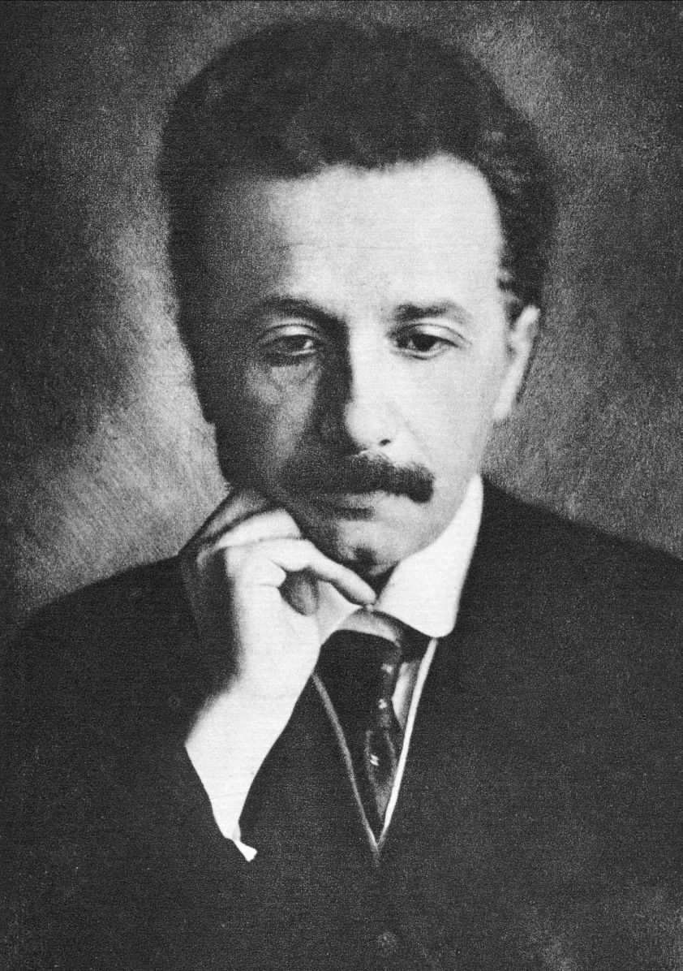
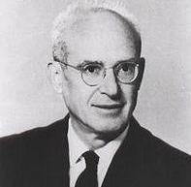

Theory of GWs
Theory of GWs
Linear GWs are Unobservable
Second-Order Perturbations
What Might Make GWs
GWs Detection Efforts
Network of Interferometers
Detected After a Century
LIGO First-Run Events
Present Situation
Extra Dimensions
Large Extra Dimension
Brane Models
Standing Waves Braneworld
Cosmological Solution
Spherical Universe
Spherical Brane
Dark Energy
Dark Matter
Radius of Shell-Universe
Diffractions From the Brane
Gravitational Waves (GW) is considered to be the fluctuations in space-time curvature that propagate through the Universe. The main stages in development of the GW theory are:
In 1916 Albert Einstein claimed that gravitational waves were an inevitable consequence of the linearized General Relativity.
In 1936 Einstein, together with Nathan Rosen, derived the opposite result and submitted the paper “Do gravitational waves exist?” to Physical Review.
On semi-centennial conference in Bern (1955) Rosen showed that the energy-momentum pseudo-tensor for Einstein-Rosen waves is vanishing.
On Chapel Hill conference in 1956 Richard Feynman proposed “sticky-bead” experiment to show that gravitational waves carry energy.

Slide 4




Linear GWs are Unobservable
Theory of GWs
Linear GWs are Unobservable
Second-Order Perturbations
What Might Make GWs
GWs Detection Efforts
Network of Interferometers
Detected After a Century
LIGO First-Run Events
Present Situation
Extra Dimensions
Large Extra Dimension
Brane Models
Standing Waves Braneworld
Cosmological Solution
Spherical Universe
Spherical Brane
Dark Energy
Dark Matter
Radius of Shell-Universe
Diffractions From the Brane
It is assumed that gravitational waves of distant sources can be described by linearized General Relativity. In the linear approximation, g_{μν} = η_{μν} + h_{μν}, Einstein’s equations can be represented by the system:
If we use expansion similar to electromagnetic or Newtonian cases, h_{ij} ↔η_{ij} φ, for the propagating field we find:
There is fundamental difference between electromagnetic and gravitational waves. The linearity of electrodynamics restricts the current to be conserved, but has no implications for T_{μν}, because it does not enter Maxwell equations.
On the other hand, T_{μν} is the source of Einstein’s equations and in the linear approximation it is strictly conserved. Thus a mechanical system cannot lose energy in the form of linear gravitational waves. The quadrupole radiation formula gives a correct answer, but the energy and momentum are transported away not by linear, but by non-linear waves.

Slide 5
Second-Order Perturbations
Theory of GWs
Linear GWs are Unobservable
Second-Order Perturbations
What Might Make GWs
GWs Detection Efforts
Network of Interferometers
Detected After a Century
LIGO First-Run Events
Present Situation
Extra Dimensions
Large Extra Dimension
Brane Models
Standing Waves Braneworld
Cosmological Solution
Spherical Universe
Spherical Brane
Dark Energy
Dark Matter
Radius of Shell-Universe
Diffractions From the Brane
To the weak field limit we keep terms which are linear in the metric perturbations h_{αβ}⁽¹⁾. However, in order to keep track of the energy carried by the GWs, we will have to extend our calculations to at least second order,
g_{αβ} = η_{αβ} + h_{αβ}⁽¹⁾ + h_{αβ}⁽²⁾ .
The second-order version of free Einstein's equations consists of all terms either quadratic in h_{αβ}⁽¹⁾ or linear in h_{αβ}⁽²⁾,
G_{αβ}⁽¹⁾(η + h⁽²⁾) + G_{αβ}⁽²⁾(η + h⁽¹⁾) = G_{αβ}⁽¹⁾(η + h⁽²⁾) - 8πGt_{αβ} = 0 .
The terms quadratic in h_{αβ}⁽¹⁾ are assumed to form an energy-momentum tensor for the gravitational field (at least in the weak field regime),
t_{αβ} = - G_{αβ}⁽²⁾(η + h⁽¹⁾) /8πG ,
as in usual field theory where the energy-momentum tensors are quadratic in fields. Also the Bianchi identity implies that t_{αβ} is conserved in the flat space.
However, there are some inconsistencies:
1). t_{αβ} is a pseudo-tensor and it is not invariant under gauge transformations;
2). It is assume that test particles move along geodesics in Minkowski space.
Then the total energy on a surface of constant time ∫t₀₀d³x and the total energy radiated through it ∫t_{0α}n^{α}d²xdt, which are invariant under special gauge ransformations that vanish sufficiently rapidly at infinity, are constructed.

Slide 6
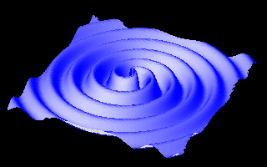
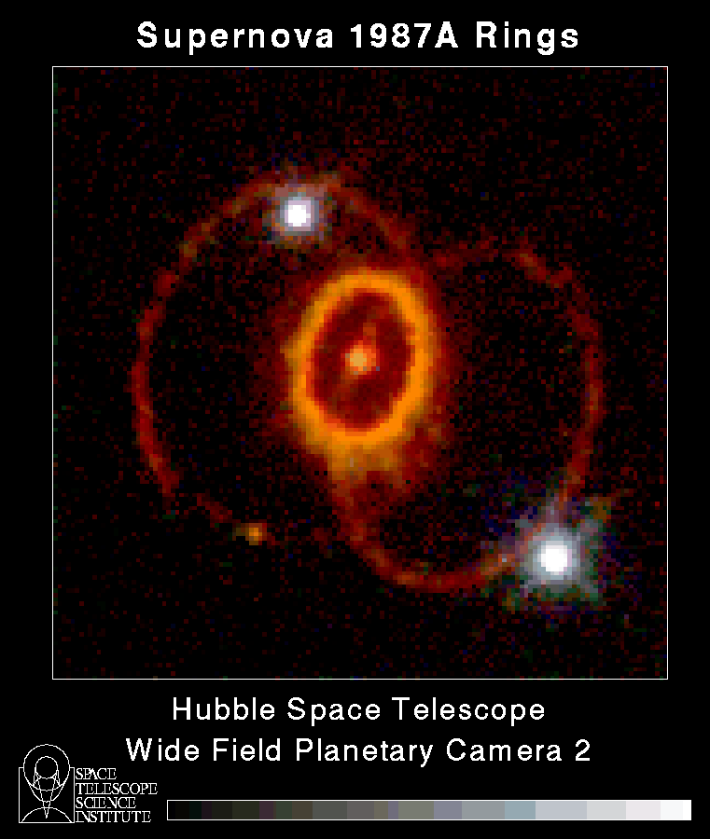
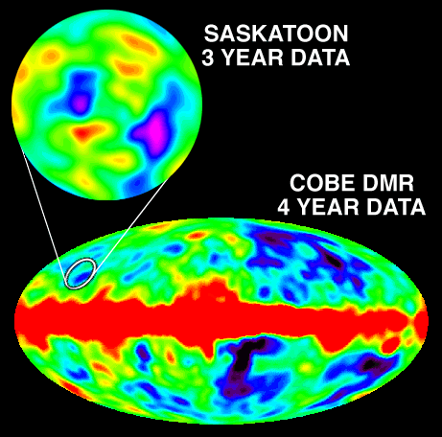
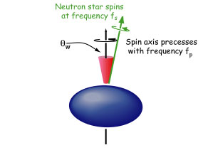
What Might Make GWs
Theory of GWs
Linear GWs are Unobservable
Second-Order Perturbations
What Might Make GWs
GWs Detection Efforts
Network of Interferometers
Detected After a Century
LIGO First-Run Events
Present Situation
Extra Dimensions
Large Extra Dimension
Brane Models
Standing Waves Braneworld
Cosmological Solution
Spherical Universe
Spherical Brane
Dark Energy
Dark Matter
Radius of Shell-Universe
Diffractions From the Brane
Compact binary inspiral: “chirps”
Supernovae: “bursts”
Cosmological Signal: “stochastic background”
Pulsars in our galaxy: “periodic”

Slide 7
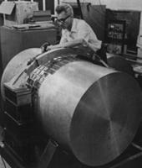

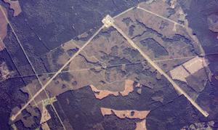
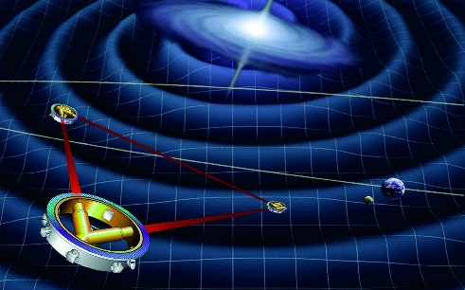
GWs Detection Efforts
Theory of GWs
Linear GWs are Unobservable
Second-Order Perturbations
What Might Make GWs
GWs Detection Efforts
Network of Interferometers
Detected After a Century
LIGO First-Run Events
Present Situation
Extra Dimensions
Large Extra Dimension
Brane Models
Standing Waves Braneworld
Cosmological Solution
Spherical Universe
Spherical Brane
Dark Energy
Dark Matter
Radius of Shell-Universe
Diffractions From the Brane
The main stages in the GW detection are:
First attempts were made in the 1960s by Weber by means of aluminum resonant bar detectors.
In 1963 Gertsenshtein and Pustovoit suggested to use Michelson-Morley type interferometers.
In 1974 Taylor and Hulse detected binary pulsar system PSR B1913+16. Later, some more relativistic binary pulsars were discovered. Orbital period decay in all cases is consistent with the energy loss predicted by General Relativity. Nobel Prize for Physics in 1993 for the first observational evidence for GW.
On 11 February 2016, the LIGO/Virgo collaboration announced the first direct observation of GWs. Later on the detection of two more GW events and some promised candidates form the 2nd run were announced.
The ESA space mission Lisa is planned to launch in 2034 and DECIGO (Japan) mission was proposed.

Slide 8
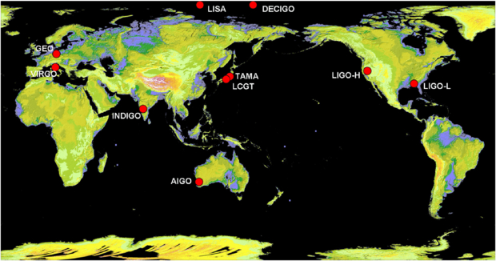
Network of Interferometers
Theory of GWs
Linear GWs are Unobservable
Second-Order Perturbations
What Might Make GWs
GWs Detection Efforts
Network of Interferometers
Detected After a Century
LIGO First-Run Events
Present Situation
Extra Dimensions
Large Extra Dimension
Brane Models
Standing Waves Braneworld
Cosmological Solution
Spherical Universe
Spherical Brane
Dark Energy
Dark Matter
Radius of Shell-Universe
Diffractions From the Brane
Ground based detectors: LIGO (USA), VIRGO (Italy), GEO (Germany), TAMA, LCGT (Japan), INDIGO (India), AIGO (Australia).
Space-based detectors (proposed): LISA (ESA, NASA?), DECIGO (Japan).
Detection Confidence; Location of Sources; Polarization Decomposition

Slide 9

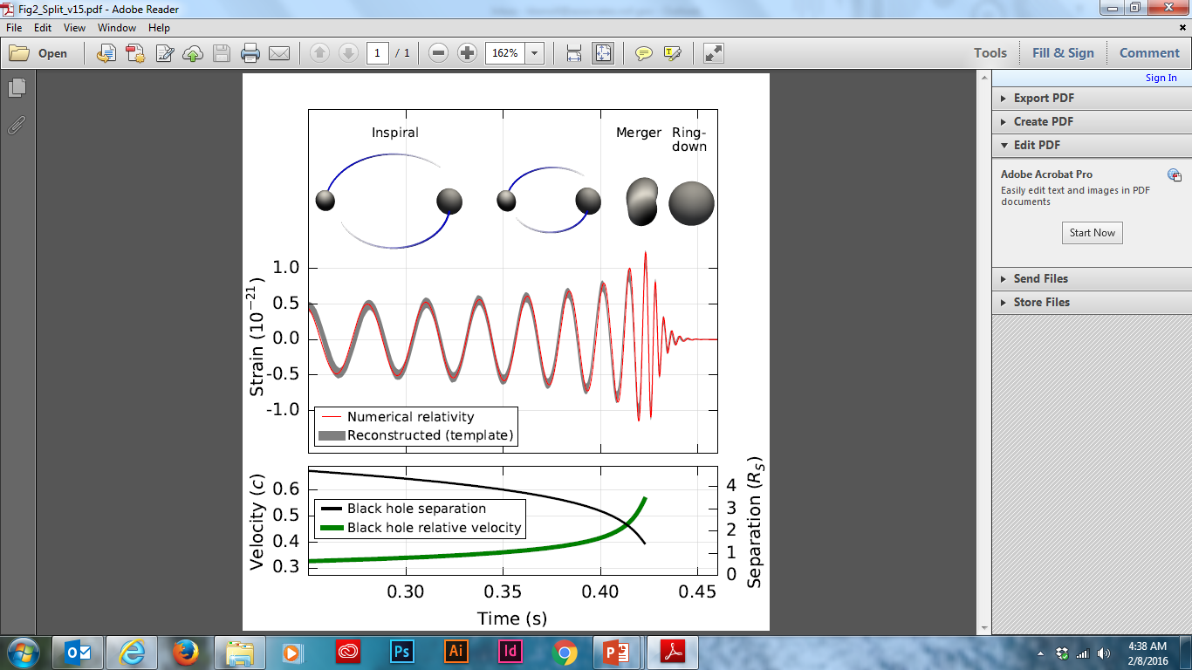
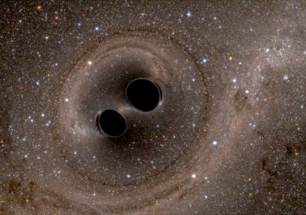
Detected After a Century
Theory of GWs
Linear GWs are Unobservable
Second-Order Perturbations
What Might Make GWs
GWs Detection Efforts
Network of Interferometers
Detected After a Century
LIGO First-Run Events
Present Situation
Extra Dimensions
Large Extra Dimension
Brane Models
Standing Waves Braneworld
Cosmological Solution
Spherical Universe
Spherical Brane
Dark Energy
Dark Matter
Radius of Shell-Universe
Diffractions From the Brane

Slide 10
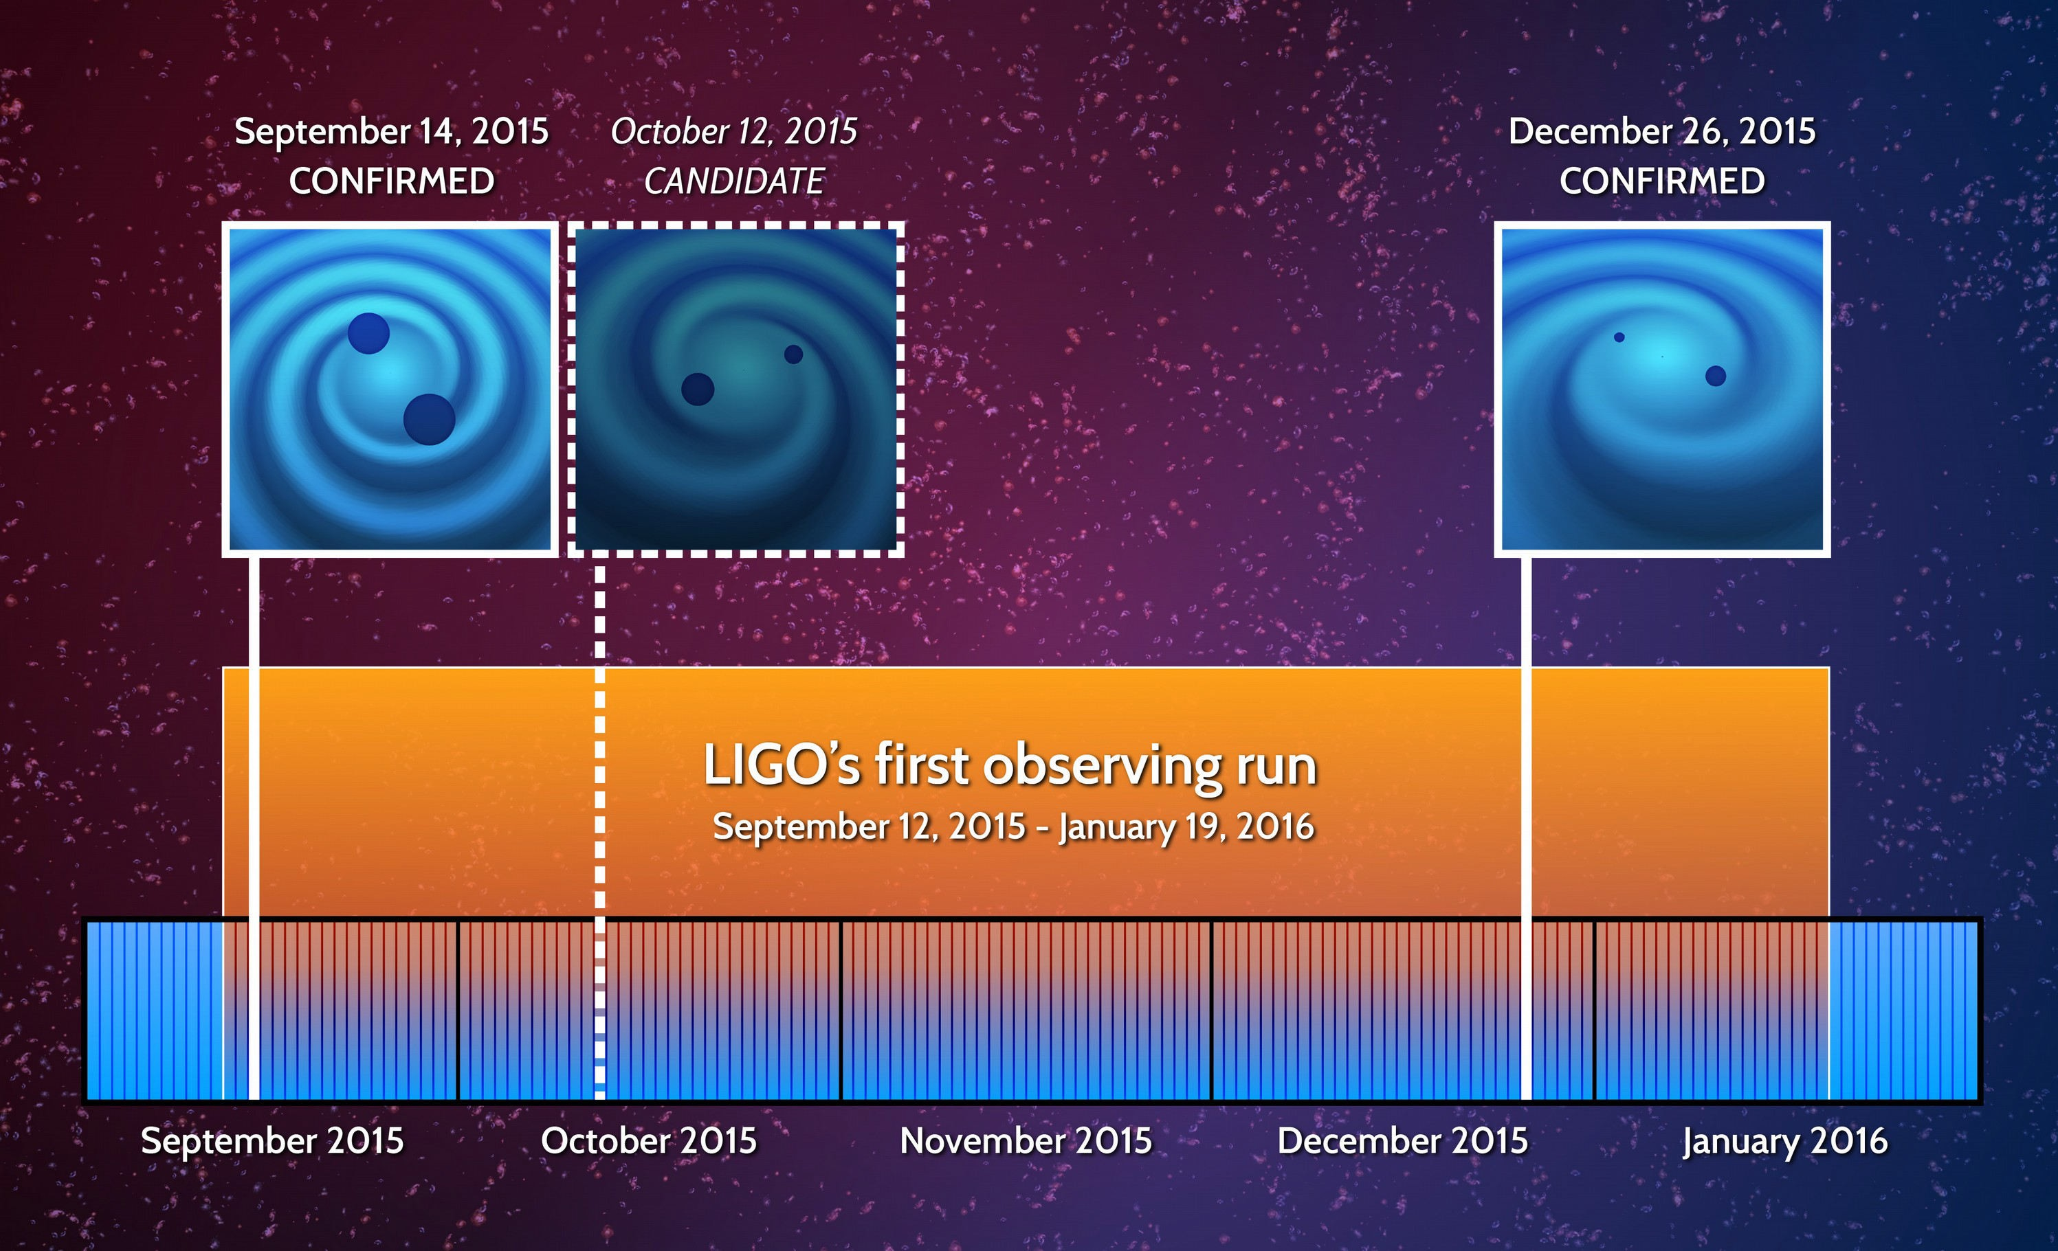
LIGO First-Run Events
Theory of GWs
Linear GWs are Unobservable
Second-Order Perturbations
What Might Make GWs
GWs Detection Efforts
Network of Interferometers
Detected After a Century
LIGO First-Run Events
Present Situation
Extra Dimensions
Large Extra Dimension
Brane Models
Standing Waves Braneworld
Cosmological Solution
Spherical Universe
Spherical Brane
Dark Energy
Dark Matter
Radius of Shell-Universe
Diffractions From the Brane

Slide 11
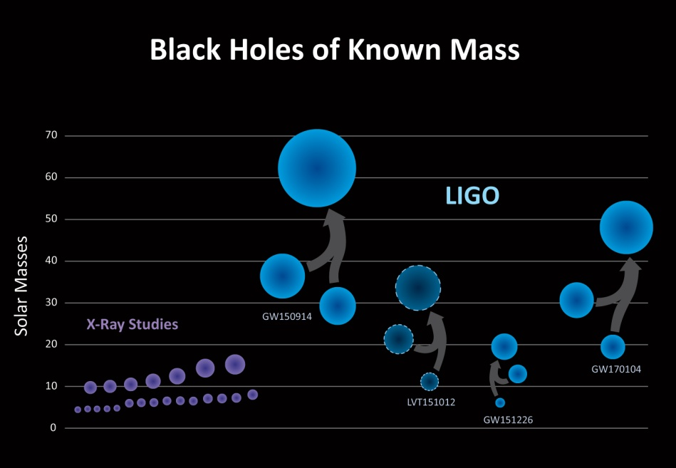
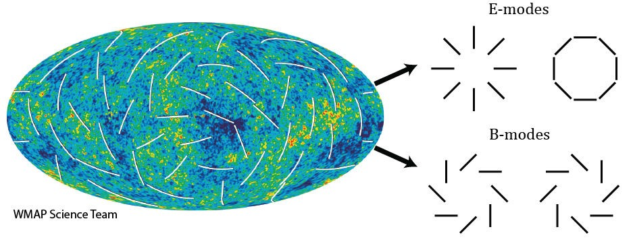
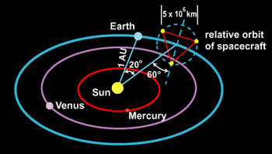
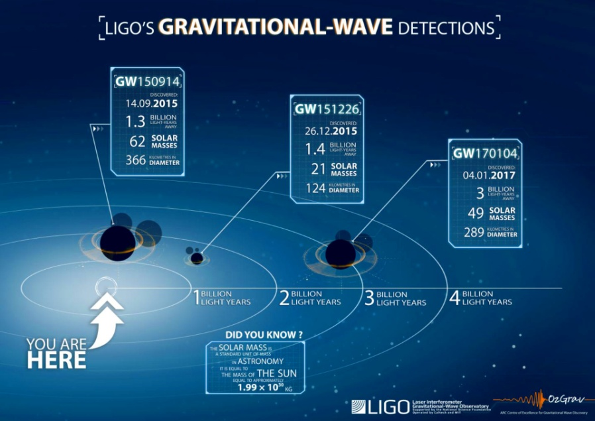
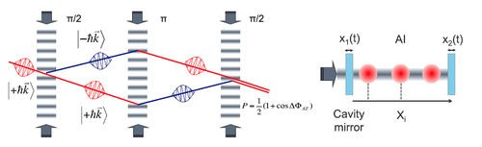
Present Situation
Theory of GWs
Linear GWs are Unobservable
Second-Order Perturbations
What Might Make GWs
GWs Detection Efforts
Network of Interferometers
Detected After a Century
LIGO First-Run Events
Present Situation
Extra Dimensions
Large Extra Dimension
Brane Models
Standing Waves Braneworld
Cosmological Solution
Spherical Universe
Spherical Brane
Dark Energy
Dark Matter
Radius of Shell-Universe
Diffractions From the Brane
Intensive efforts to find burst, binary coalescence, continuous wave, stochastic GWs in coincidence with EM and neutrino signals;
Stochastic background of relict GWs could be observed in a few years;
The universe has more stellar mass BHs than expected;
LISA (ESA): three Interferometers 2.5×10⁶ km arm lengths. Planned launch 2034 (earlier launch 2028?);
LIGO 2nd run ended, Virgo joined in August 2017, some promising candidates (colliding neutron stars?); LCGT and INDIGO will join in the coming years;
3rd generation detectors: Einstein Telescope (EU) and Cosmic Explorer (US), with atom interferometers in 0.1–10 Hz (between LISA and LIGO-Virgo).

Slide 12
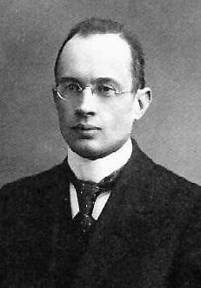

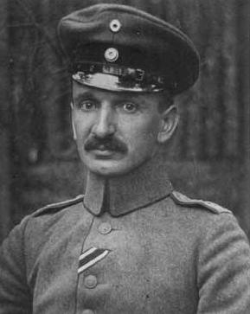

Extra Dimensions
Theory of GWs
Linear GWs are Unobservable
Second-Order Perturbations
What Might Make GWs
GWs Detection Efforts
Network of Interferometers
Detected After a Century
LIGO First-Run Events
Present Situation
Extra Dimensions
Large Extra Dimension
Brane Models
Standing Waves Braneworld
Cosmological Solution
Spherical Universe
Spherical Brane
Dark Energy
Dark Matter
Radius of Shell-Universe
Diffractions From the Brane
Analogies between electrodynamics and gravity played important role also in development of extra dimensional models .
The first proposal that our world can have more than four dimensions was introduced by Gunnar Nordström in 1914. He started from the 5-dimensional Maxwell’s Lagrangian,
He imposed the ‘cylinder condition’ (that the fields should not depend on the fifth coordinate) and arrived at the unification of electromagnetism with his theory of scalar gravity.
On the contrary, Theodor Kaluza in 1919 had started from 5-dimensional Hilbert’s Lagrangian for gravity,
He, like Nordström, assumed the ‘cylinder condition’ and introduced electromagnetic and scalar fields as geometrical objects.

Slide 13

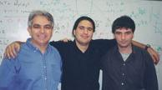
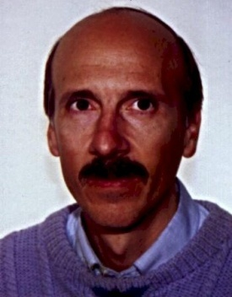
Large Extra Dimension
Theory of GWs
Linear GWs are Unobservable
Second-Order Perturbations
What Might Make GWs
GWs Detection Efforts
Network of Interferometers
Detected After a Century
LIGO First-Run Events
Present Situation
Extra Dimensions
Large Extra Dimension
Brane Models
Standing Waves Braneworld
Cosmological Solution
Spherical Universe
Spherical Brane
Dark Energy
Dark Matter
Radius of Shell-Universe
Diffractions From the Brane
Also they introduce the metric ansatz to cancel a cosmological constant,
ds²= ϕ²(ξ)g_{αβ}(x^{ν})dx^{α}dx^{β} - dξ² .
[1] V. A. Rubakov and M. E. Shaposhnikov, Phys. Lett. B125 (1983) 136; 139.
[2] N. Arkani-Hamed, S. Dimopoulos and G. Dvali, Phys Lett. B429 (1998) 263.
[3] C. D. Hoyle, et all, Phys.Rev. D 70 (2004) 042004.
An alternative to compactification was introduced in 1983 by Rubakov and Shaposhnikov [1]. They proposed that ordinary matter might be trapped on a brane by kink-like solution th(ξ) of some scalar field, e.g. for fermions,
iγ^{A}∂_{A} ψ - th(ξ) ψ = 0 .
To solve the hierarchy problem Arkani-Hamed, Dimopoulos and Dvali in 1998 considered compact but macroscopic extra dimensions [2]. In their model 4-dimensional Plank’s scale is not a fundamental constant,
m_{Pl}² = VM^{2+d} ,
but depends on the extra volume element V and the number of extra dimensions d. This predicts deviation from Newton’s law on short distances. At present time 4-dimensional law of gravitation is established experimentally down to the distances 0.1 mm [3].
Notes:
mera

Slide 14
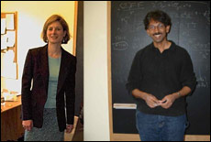
Brane Models
Theory of GWs
Linear GWs are Unobservable
Second-Order Perturbations
What Might Make GWs
GWs Detection Efforts
Network of Interferometers
Detected After a Century
LIGO First-Run Events
Present Situation
Extra Dimensions
Large Extra Dimension
Brane Models
Standing Waves Braneworld
Cosmological Solution
Spherical Universe
Spherical Brane
Dark Energy
Dark Matter
Radius of Shell-Universe
Diffractions From the Brane
The main obstacle in the progress of the models with large extra dimensions was to trap Newton’s gravity on the brane. In [1] the cancellation mechanism was introduced. In the Newton approximation the 5-dimensional Einstein equations with the cosmological term Λ for the trapped source
(Δ - Λ)g₀₀ = GMδ(r)δ(ξ) ,
(ξ is the 5th coordinate, Δ is 4-dimensional Laplasian) has the warped solution,
g₀₀ = η₀₀exp(±Λ^{1/2}| ξ |) .
On the brane we have effective 4-dimensional Newton’s formula
η₀₀ = 1 – 2gM/r ,
where g ∼ GΛ^{1/2} is the 4-dimensional gravitational constant.
At the distances of the brane thickness one must use multi-dimensional delta function δ(R) and 5-dimensional Newton’s law is restored
g₀₀ = 1 – 2GM/R² .
[1] M. Gogberashvili, Int. J. Mod. Phys. D 11 (2002) 1635 [hep-ph/9812296].
[2] L. Randall and R. Sundrum, Phys. Rev. Lett. 83 (1999) 3370 [hep-ph/9905221].
This mechanism of trapping of 4-dimensional gravity on the brane becomes famous after the papers of Lisa Randall and Roman Sundrum [2], which appear half an year later after [1].
Notes:
mera

Slide 15
Standing Waves Braneworld
Theory of GWs
Linear GWs are Unobservable
Second-Order Perturbations
What Might Make GWs
GWs Detection Efforts
Network of Interferometers
Detected After a Century
LIGO First-Run Events
Present Situation
Extra Dimensions
Large Extra Dimension
Brane Models
Standing Waves Braneworld
Cosmological Solution
Spherical Universe
Spherical Brane
Dark Energy
Dark Matter
Radius of Shell-Universe
Diffractions From the Brane
Pure gravitational localization mechanism within the 5D standing wave braneworld: a single brane which bounds collective oscillations of gravitational u(t,r) and scalar field σ(t,r) standing waves [1],
ds² = e^{2a|r|}(dt² - e^{u}dx² - e^{u}dy² - e^{-2u}dz²) - dr² .
For the case of the gost bulk scalar field,
u(t,r) ~ σ(t,r) ~ sin(ωt) e^{-2ar} J₂(ωe^{-ar}/a) ,
and for real bulk scalar field oscillations are π/2 out of phase,
u(t,z) ~ A cos(ωt) J₀(ωr + ω/k) , σ(t,r) ~ sin(ωt) J₀(ωr + ω/k) ,
where a ~ Λ₅^{1/2} is the curvature scale and J₀(r) and J₂(r) are Bessel functions.
Oscillations must vanish on the brane. This quantizes the frequency of the standing waves (zeros of Bessel functions). Correspondingly, σ(t,r) and u(t,r) vanish at number of points (nodes) in the bulk, which can be considered as 4D space-time ‘islands’, where the matter particles are assumed to be bound.
We have several dimensional parameters, distances between the peaks and nodes of the left and right fermionic wavefunctions. The structure of peaks leads to the observed mass spectrum of the up and down quark families [2].
[1] M. Gogberashvili, et all, Int. J. Mod. Phys. D25 (2016) 1630019 (Review);
[2] M. Gogberashvili and G. Tukhashvili, J. Theor. Phys. 54 (2015) 1154.

Slide 16
Cosmological Solution
Theory of GWs
Linear GWs are Unobservable
Second-Order Perturbations
What Might Make GWs
GWs Detection Efforts
Network of Interferometers
Detected After a Century
LIGO First-Run Events
Present Situation
Extra Dimensions
Large Extra Dimension
Brane Models
Standing Waves Braneworld
Cosmological Solution
Spherical Universe
Spherical Brane
Dark Energy
Dark Matter
Radius of Shell-Universe
Diffractions From the Brane
If we relax the condition of proportionality of scalar and gravitational fields:
σ(t,r) ~ u(t,r) – 2Ht ,
H is a constant, the system of Einstein and scalar field equations has exact solution corresponding to the standing waves with t-depended amplitude:
ds² = e^{2a|r|}(dt² – e^{u-Ht}dx² – e^{u-Ht}dy² - e^{-2u+2Ht}dz²) - dr² .
The amplitude of scalar waves increases/decreases with t depending on H.
1). If H > 0, the amplitude of σ(t,r) decreases, while space expands exponentially in z and squeezes in x-y directions, brane shrinks into 1-string.
2). H < 0, the amplitude increases, z-distances decrease and x-y plane expands.
The mechanism can be relevant for dimensional reduction in string theories [1]
As the anisotropic energy of the 3-brane leaks into the bulk the braneworld isotropizes by itself and the phantom scalar field exponentially vanishes [2].
[1] M. Gogberashvili, A. Herrera-Aguilar, D. Malagón-Morejón and R.R.
Mora-Luna, Phys. Lett. B 725 (2013) 208.
[2] M. Gogberashvili, A. Herrera-Aguilar, D. Malagón-Morejón, R.R.
Mora-Luna and U. Nucamendi, Phys. Rev. D 87 (2013) 084059.

Slide 17
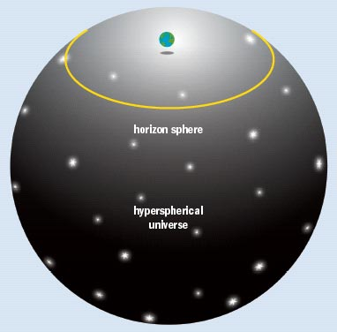
Spherical Universe
Theory of GWs
Linear GWs are Unobservable
Second-Order Perturbations
What Might Make GWs
GWs Detection Efforts
Network of Interferometers
Detected After a Century
LIGO First-Run Events
Present Situation
Extra Dimensions
Large Extra Dimension
Brane Models
Standing Waves Braneworld
Cosmological Solution
Spherical Universe
Spherical Brane
Dark Energy
Dark Matter
Radius of Shell-Universe
Diffractions From the Brane
When the density Ω is 2% more than the critical density, the horizon radius (yellow line) would be about 46 billion light-years and the radius of curvature of the hyper-sphere would be 2.6 times greater.
[1] J.L. Tonry, et al., Astrophys J. 594 (2003) 1.
[2] M. Gogberashvili, Europhs. Lett. 49 (2000) 396; Phys. Lett. B 636 (2006) 147.
The analysis of CMB data combined with other astronomical observations suggests that the universe has small positive curvature (corresponding to Ω = 1,02), i.e. is finite [1]. The model with similar topology (where the universe is considered as an expanding 3-brane in 5-dimensional space-time) was introduced in [2]. This scenario proposes obvious explanation of the isotropic runaway of galaxies, the deficiency in the first modes of CMB and the existence of the cosmological preferred frame.

Slide 18
Spherical Brane
Theory of GWs
Linear GWs are Unobservable
Second-Order Perturbations
What Might Make GWs
GWs Detection Efforts
Network of Interferometers
Detected After a Century
LIGO First-Run Events
Present Situation
Extra Dimensions
Large Extra Dimension
Brane Models
Standing Waves Braneworld
Cosmological Solution
Spherical Universe
Spherical Brane
Dark Energy
Dark Matter
Radius of Shell-Universe
Diffractions From the Brane
The external solution of the Einstein equations for the located at a = R spherical brane in 5D AdS has the form [1]:
ds² = U²dt² - da² - A²[dα² + sin²α (dθ² + sin²θdφ²)] ,
A² = (R² + 2ε²)e^{-(a-R)/ε} - 2ε² , U² = R²e^{-(a-R)/ε}/A² .
For the large size of the shell the angle α corresponds to the 4D radial coordinate by A sin α. The metric functions A and U become zero at some distance. Thus space-time of the shell has horizons on both side of the brane.
We can translate the solutions from the Gaussian into the Schwartzschild coordinates by r = A, which gives:
ds² = D dt² - dr²/D – r²[dα² + sin²α (dθ² + sin²θdφ²)] ,
D = 1 - 2Gm/r² + Λr²/6 , 2Gm = - ε² = - 3/2Λ .
Because of the positive value of the potential in D, we conclude that spherical brane in AdS have negative active gravitational mass
m = - 3/4GΛ .
This means that static spherical brane is gravitationally repulsive in agreement with Tolman’s formula for domain walls [2].
[1] M. Gogberashvili, Mod. Phys. Lett. A 23 (2008) 2979.
[2] A. Barnaveli and M. Gogberashvili, Gen. Rel. Grav. 26 (1994) 1117.

Slide 19
Dark Energy
Theory of GWs
Linear GWs are Unobservable
Second-Order Perturbations
What Might Make GWs
GWs Detection Efforts
Network of Interferometers
Detected After a Century
LIGO First-Run Events
Present Situation
Extra Dimensions
Large Extra Dimension
Brane Models
Standing Waves Braneworld
Cosmological Solution
Spherical Universe
Spherical Brane
Dark Energy
Dark Matter
Radius of Shell-Universe
Diffractions From the Brane
The Schwartzschild-like solutions for the shell-universe in five dimensions we take as [1],
ds² = Udt² - da²/U - a²[dα² + sin²α (dθ² + sin²θdφ²)] ,
U₊ = 1 – 2GM/a² + Λ₊ a²/6 , U₋ = 1 + Λ₋ a²/6 ,
M is the total mass of the universe and a is the cosmological scale factor.
In thin-wall formalism equation of motion of the shell has the form
á² = - 1 + σ²a²/4+ (Λ₋ - Λ₊)²a²/4σ² - (Λ ₊ + Λ₋)a²/2 +
+ GM(σ² + Λ₋ - Λ₊)/a²σ² + G²M²/a⁶σ².
The intrinsic energy density of the shell-universe is
σ ~ lim (ε →0) ∫ 6π²GT⁰₀ da ~ GM/a³ ~ 2π²G₄ ερ ~ εH₀ ,
where G₄ is the Newton constant, H₀ is the Hubble parameter, ε is the thickness of the brane and
ρ = M/2π²R³
is the present value of the mean mass density on the shell.
Because of the standard cancellation between the brane tension and cosmological constant σ << Λ±. Thus dynamics of the shell-universe is governed mainly by Λ ± and can be explained without introducing dark energy component on the brane.
[1] M. Gogberashvili, Europhs. Lett. 49 (2000) 396; Phys. Lett. B 636 (2006) 147.

Slide 20
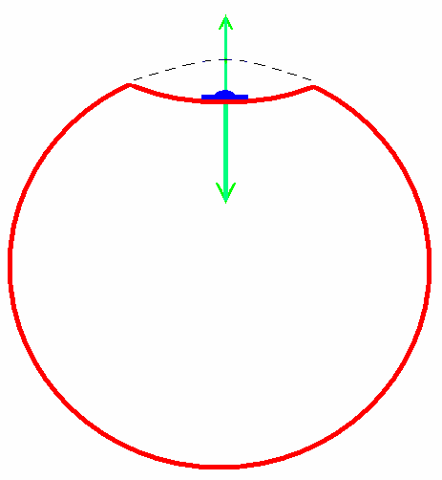
Dark Matter
Theory of GWs
Linear GWs are Unobservable
Second-Order Perturbations
What Might Make GWs
GWs Detection Efforts
Network of Interferometers
Detected After a Century
LIGO First-Run Events
Present Situation
Extra Dimensions
Large Extra Dimension
Brane Models
Standing Waves Braneworld
Cosmological Solution
Spherical Universe
Spherical Brane
Dark Energy
Dark Matter
Radius of Shell-Universe
Diffractions From the Brane
Attracted by the Shell-Universe a galaxy leads to the bending of the brane y = y₀ – ξ (x^{ν}). The local increment of the brane tension has the form:
δσ = D(Δξ)² ,
where Δ is 3-Laplasian and D is the ‘stiffness’ coefficient. The equation that describes the deformation of an elastic plate,
Δ²ξ = πκ²σT₀₀/8D ,
gives δσ ~ 1/r² [1]. Than the Einstein equations in the Newton limit reduce to [2]
Δφ = 4πG(δσ + T₀₀) .
y
The first term leads to the extra logarithmic potential far from the galaxy centre. Thus the gravitational acceleration of a test particle is modified
|a| = -∂φ = f GM/r²,
where f _{r<<r0} = 1, f _{r >>r0} = r/r₀ and imitates dark matter in galaxies [3].
[1] M. Gogberashvili and M. Maziashvili, GRG 37 (2005) 1129.
[2] K. Maeda and M. Sasaki, Phys Rev. D 62 (2000) 024012.
[3] M. Milgrom, Astrophys. J. 270 (1983) 365.
^{Brane}
^{Λ}₊
^{Galaxy}
^{Λ}₋
^{Gravitational force}

Slide 21
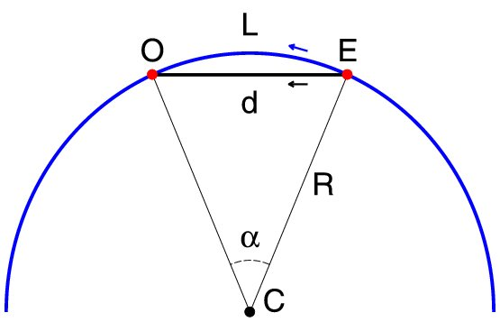
Radius of Shell-Universe
Theory of GWs
Linear GWs are Unobservable
Second-Order Perturbations
What Might Make GWs
GWs Detection Efforts
Network of Interferometers
Detected After a Century
LIGO First-Run Events
Present Situation
Extra Dimensions
Large Extra Dimension
Brane Models
Standing Waves Braneworld
Cosmological Solution
Spherical Universe
Spherical Brane
Dark Energy
Dark Matter
Radius of Shell-Universe
Diffractions From the Brane
The gravitational pulse can make a shortcut d between the source E and the observer O, while the distance travelled by the photons on the spherical brane is represented by an arc length L. The distance excess due to the curvature of the brane is
Δx = L – d ≈ Rα³/24,
where α ≈ d/R is the central angle.
In the case of the Fermi GBM transient, which arrived Δt = 0.4 s later relative to GW150914, one can find,
Δx ≈ 10⁵ km , d ≈ 10²² km , R ≈ 10³⁰ km ,
which is much larger than the radius of the observable universe (Hubble sphere H = R./R). Then we get the constraint on the spatial curvature density of our Universe [1],
|Ω_{K}| = |-1/R² H²| < 10⁻¹⁴
which is much stringent than the one deduced by PLANK, |Ω_{K} |< 0.005.
[1] M.Gogberashvili, A.Sakharov, E.Sarkisyan-Grinbaum, Phys. Lett. B763 (2016) 397

Slide 22
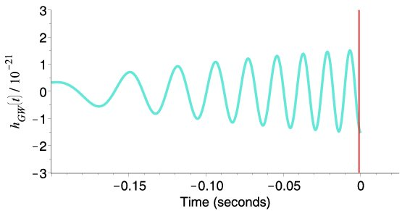
Diffractions From the Brane
Theory of GWs
Linear GWs are Unobservable
Second-Order Perturbations
What Might Make GWs
GWs Detection Efforts
Network of Interferometers
Detected After a Century
LIGO First-Run Events
Present Situation
Extra Dimensions
Large Extra Dimension
Brane Models
Standing Waves Braneworld
Cosmological Solution
Spherical Universe
Spherical Brane
Dark Energy
Dark Matter
Radius of Shell-Universe
Diffractions From the Brane
Zero mode gravitons with the wavelength λ < ε ~ 1/Λ^{1/2} (ε is the brane width and Λ is the bulk cosmological constant) can be reflected from the brane walls.
For the diffraction angle we use the analogy with X-rays, φ² = θ² + δ (θ = x/L, where x is the coordinate along the interference pattern and δ is the asymmetric diffraction parameter). For the distribution of intensity produced by a single-slit diffraction, I(x) = A ²(sin β/β)², where A < 1 is the amplitude of the plane GWs, h_{αβ} = A C_{αβ} sin (k_{ν}x^{ν}), and β(x) = επ sin φ/λ. For the minima of intensity:
β(θ) - β(0) = πN ≈ επ cos δ^{1/2} θ²/2 δ^{1/2}λ ,
were N is a integer and we suppose: λ/ ε ~ M_{H} /M_{Pl} ≈ 10⁻¹⁵, A ~ 10⁻⁴ , δ ~ 10⁻¹⁸.
The coordinate of intensity minimums
x² = 2 δ^{1/2}λNL ²/ε.
Due to moving with the velocity of Earth, 10³km/s, the resulting strain,
h_{GW} (t) = Δl/l = ΔI,
(distance between mirrors l ≈ 5 km) imitates the event GW150914 [1].
[1] M. Gogberashvili and P. Midodashvili, Europhys. Lett. 114 (2016) 50008

Slide 23
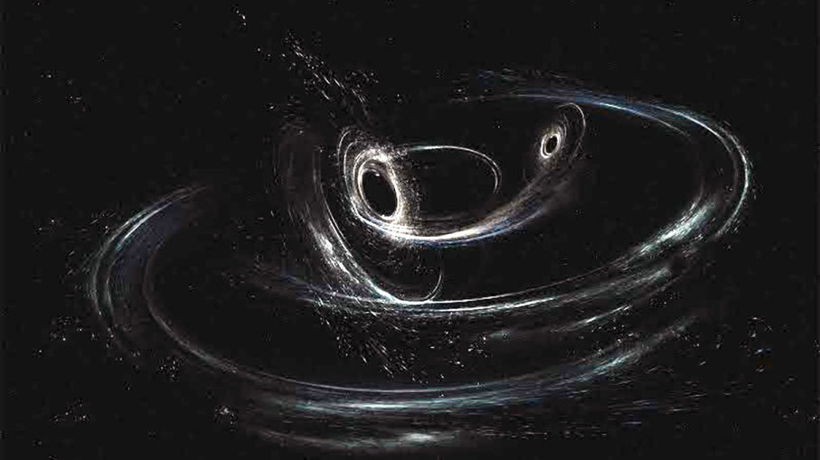
Conclusions
Short reviews on GWs and Brane Models were done.
GWs can be reflected from the brane walls and form an interference pattern. The LIGO signals possibly are manifestations of interference of burst GWs, for example in the Standing Wave Braneworld scenario.
Assuming that the Fermi GBM transient was follow-up of GW150914 a bound on the spatial curvature in the Spherical Braneworld model was found.

Slide 24

Thank You for Your Attention

