Slide 1
''From quarks to multiquark states:
algebraic aspects and physics''
Paul SORBA
(LAPTH, CNRS, France)
paul.sorba@lapth.cnrs.fr Tbilissi, sept.2017

Slide 2
Contents
1) Introduction: from quarks to multiquarks
2) A short tutorial on group theory.
3) Quarks and flavor symmetry: a minimalist presentation
4) The ǫǫǭǭ case
5) The ǫǫǫǫǭ case

Slide 3
1) Introduction
Quarks and hadrons: a reminder
Before the Quarks:
‘’The Eightfold way: a Theory of Strong Interaction Symmetry’’
(M.Gell-Mann, 1961)
Then the Quarks :
‘’A Schematic Model of Baryons and Mesons’’
(M.Gell-Mann,1964; see also Zweig, 1964)
The Quarks are Coloured :
‘’Three-Triplet Model with double SU(3) Symmetry’’
(M.Y.Han and Y.Nambu,1965)
And QCD with the gluons :
‘’Advantages of the Color octet gluon picture’’
(H.Fritzsch, M.Gell-Mann, H.Leutwyler,1973)

Slide 4
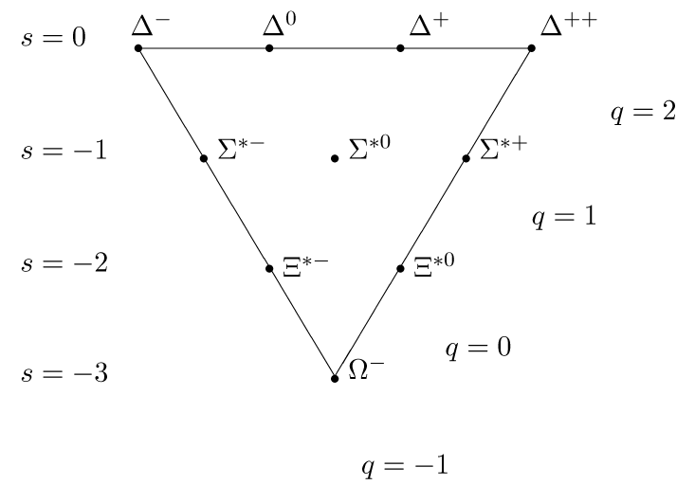
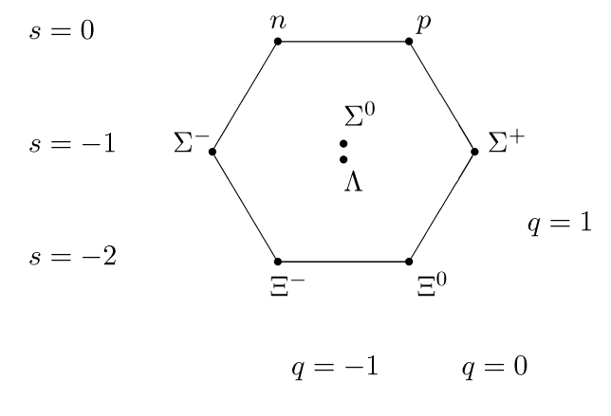
The Eightfoldway
Baryon Octet & Decuplet

Slide 5
Hadrons are singlets of colour
Baryons… Mesons…

Slide 6
But there are states with more than three quarks which are singlets of colour…

Slide 7
Multiquark states
‘’Multiquark hadrons: phenomenology of ǫǫǭǭ mesons and methods’’ and ‘’Perhaps a stable dyhyperon’’
(R.L.Jaffe, 1977) in MIT bag model
‘’Is Deuteron a six quark system’’
(V.A.Matveev and P.S., 1977) Hidden Colour
‘’ Baryonium states (ǫǫǭǭ) in multiquark spectroscopy’’
(Chan Hong-Mo and H.Hogaasen, 1977)
‘’The systematics of possibly narrow quark states (ǫǫǫǫǭ) with baryon number one:’’
(H.Hogaasen and P.S., 1978) Coloured clusters and L orb. Mom.

Slide 8
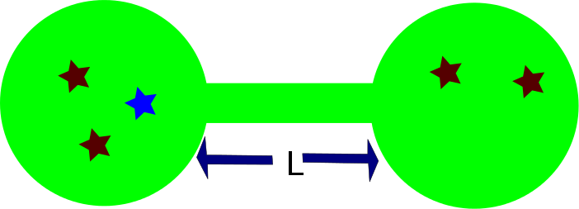
2 different situations :
S-wave
L ≠ 0

Slide 9
Main points
A multiquark state must be a singlet of colour.
Then, with more than three quarks, different configurations are present.
Stability:
a) from Mass formula with quarks submitted to chromomagnetic interaction*, checking whether the pentaquark mass is smaller than the sum of masses of the baryon and meson in its eventual decay.
b) two coloured clusters connected by an L non zero orbital angular momentum, keeping them distant
*good results obtained for usual hadrons

Slide 10
=
Different configurations: SU(3) colour :product of representations
3 x 3bar = 1+ 8 meson
3 x 3 x 3 = (3bar+ 6) x 3 = (1+8) + (10 +8) baryon
(qqqqqq) = (qqq)x (qqq) dibaryon
c =1 c=1 x c=1
or c=8 x c=8
(qqqbarqbar)= (qq) x (qbarqbar) or (qqbar) x (qqbar) baryonium
c=1 c=3 x c=3bar c=1 x c=1
c=6bar x c=6 c=8 x c=8
(qqqqqbar) = (qqq) x (qqbar) or (qqqbar) x (qq) mesobaryonium or
c=1 c=1 x c= 1 c= 3 x c = 3bar pentaquark
c=8 x c=8 c= 6bar x c = 6

Slide 11
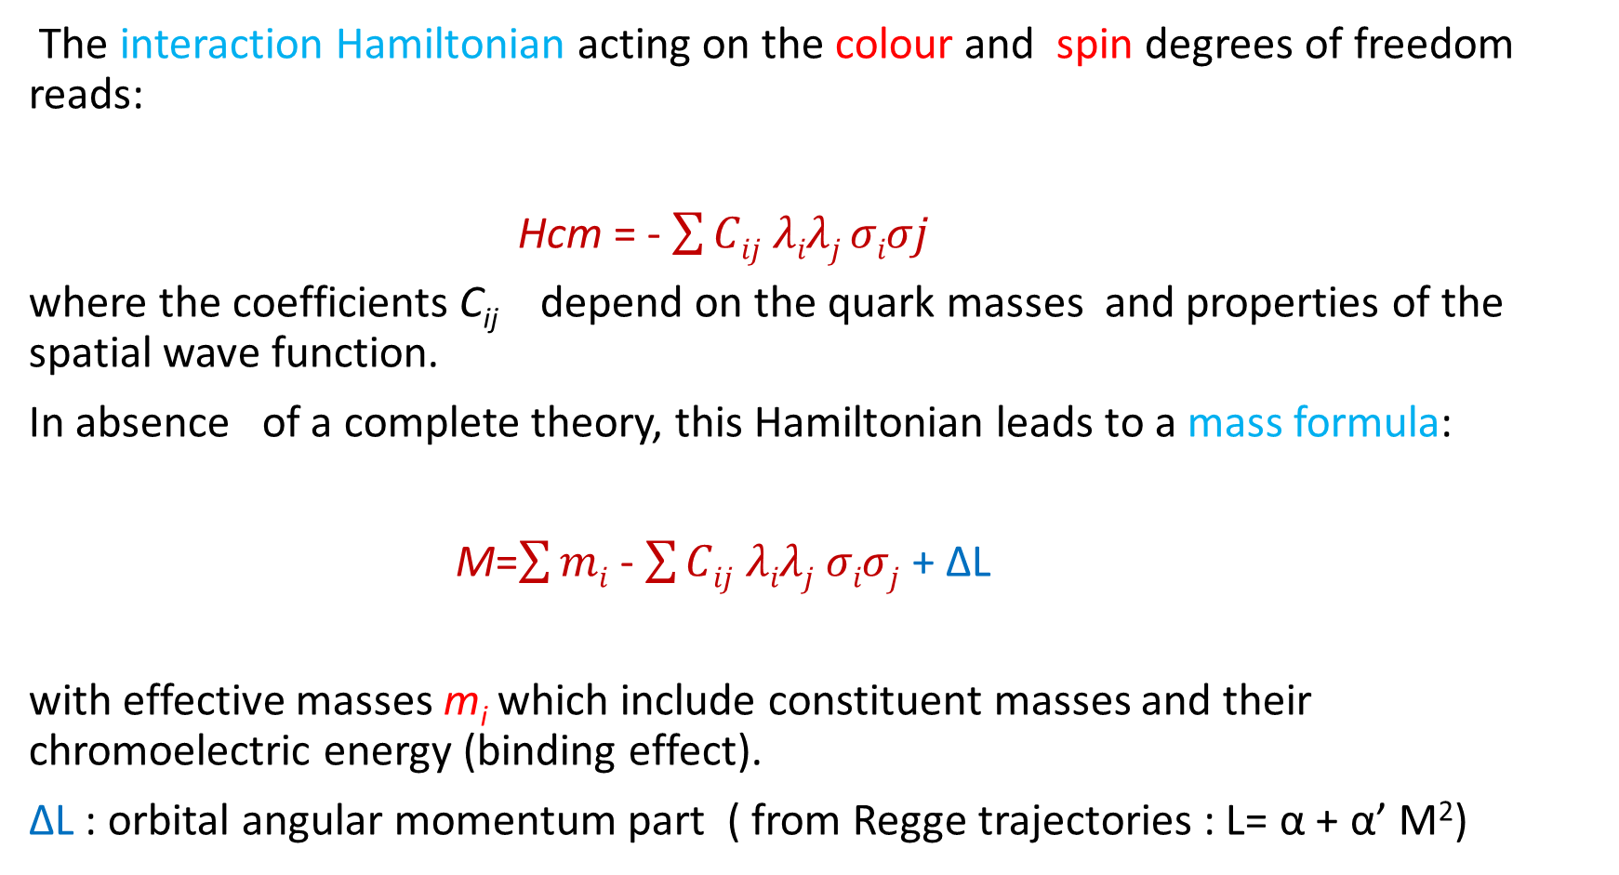
Masses
The interaction Hamiltonian acting on the colour and spin degrees of freedom reads:
Hcm = - $\sum{Cij}$ $λiλj σiσj$
where the coefficients C_{ij} depend on the quark masses and properties of the spatial wave function.
In absence of a complete theory, this Hamiltonian leads to a mass formula:
M=$\sum{mi}$ - $\sum{Cij}$ $λiλj σiσj$ + ∆L
with effective masses m_{i} which include constituent masses and their chromoelectric energy (binding effect).
∆L : orbital angular momentum part ( from Regge trajectories : L= α + α’ M²)

Slide 12
Computations might be heavy.
So, let us first limit consider the case of usual baryons.
But, before, let us briefly comment on the main algebraic tool we use, i.e. group theory.

Slide 13
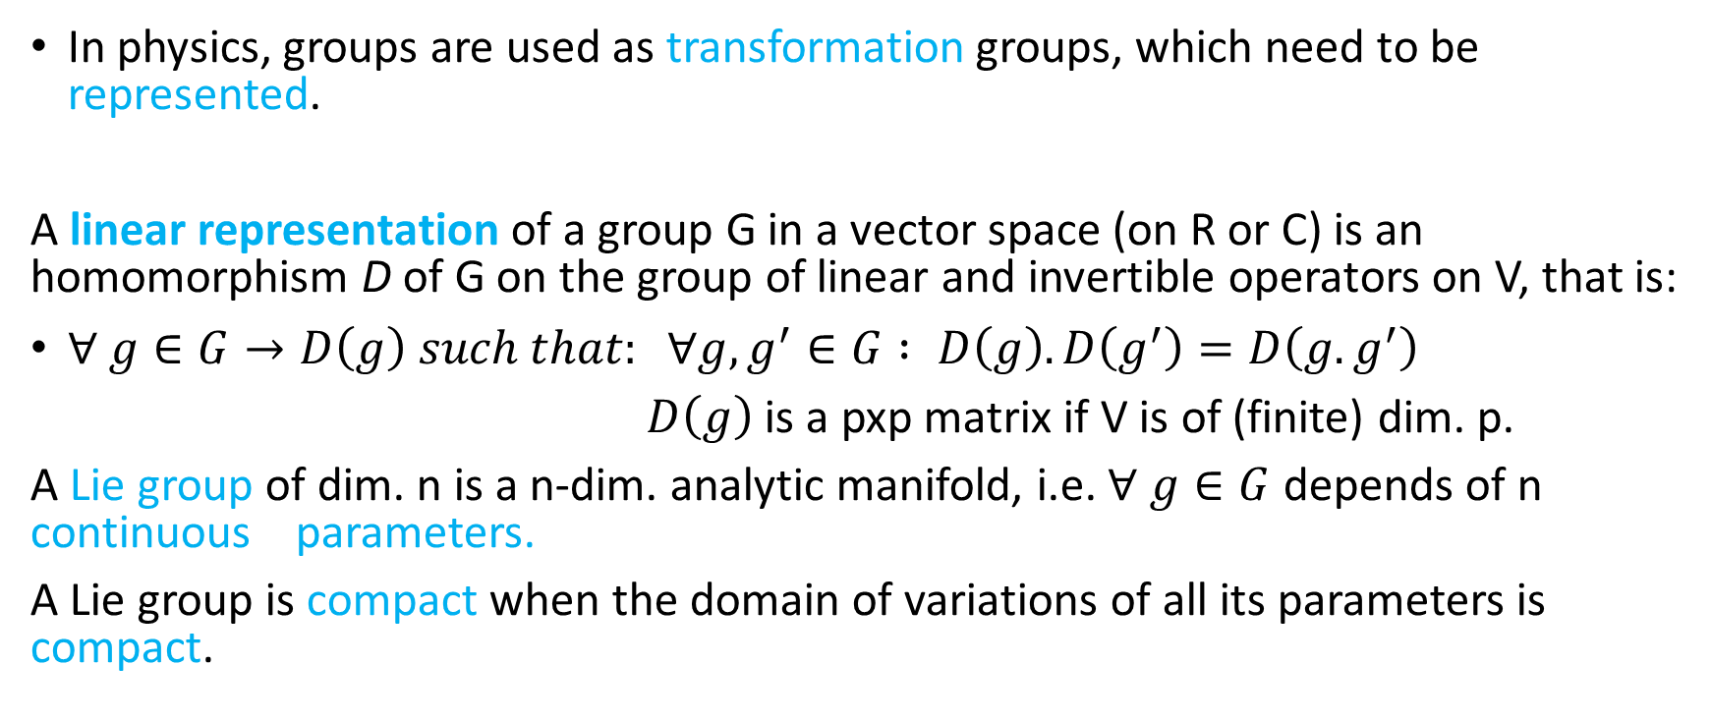
2) A (really) short tutorial on Group Theory
In physics, groups are used as transformation groups, which need to be represented.
A linear representation of a group G in a vector space (on R or C) is an homomorphism D of G on the group of linear and invertible operators on V, that is:
$∀ g∈G→D\left(g\right) such that: ∀g,g^{′}∈G : D\left(g\right).D\left(g^{′}\right)=D\left(g.g^{′}\right)$
$D\left(g\right)$ is a pxp matrix if V is of (finite) dim. p.
A Lie group of dim. n is a n-dim. analytic manifold, i.e. $∀ g∈G$ depends of n continuous parameters.
A Lie group is compact when the domain of variations of all its parameters is compact.

Slide 14
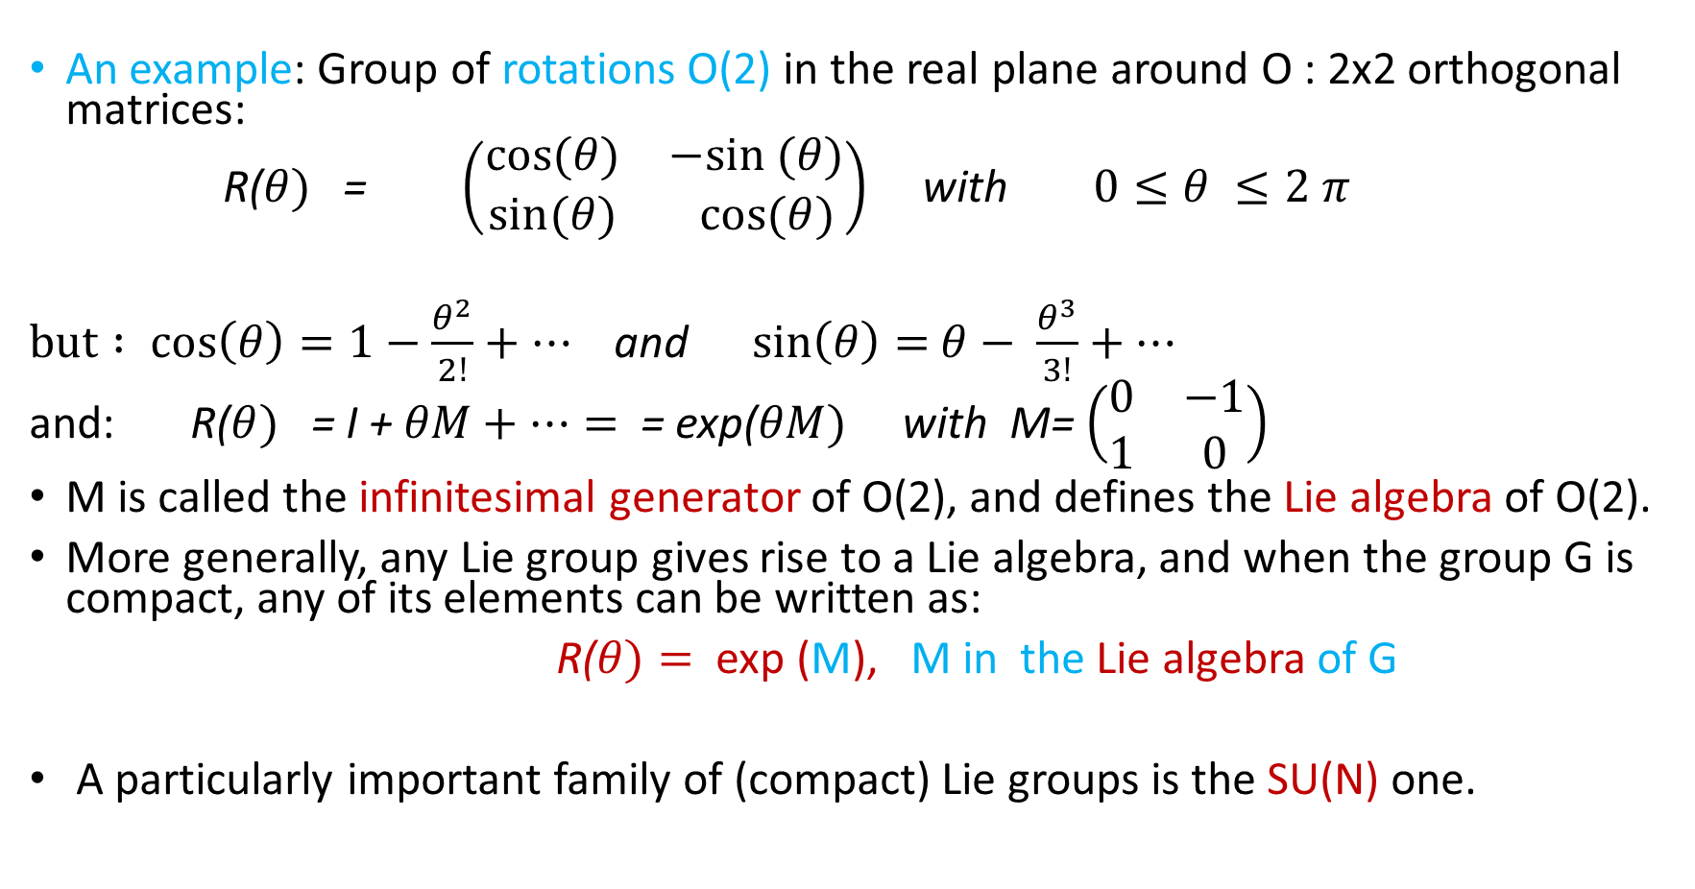
An example: Group of rotations O(2) in the real plane around O : 2x2 orthogonal matrices:
R($θ)$ = $\left(\begin{matrix}cos(θ) & −sin (θ) \\ sin(θ) & cos(θ)\end{matrix}\right)$ with $0≤θ ≤2 π$
$but : cos\left(θ\right)=1−\frac{θ^{2}}{2!}+…$and $\sin\left(θ\right)=$ $θ− \frac{θ^{3}}{3!}+…$
and: R($θ)$ = I + $θM+…=$ = exp(${θM)}^{}$ with M= $\left(\begin{matrix}0 & −1 \\ 1 & 0\end{matrix}\right)$
M is called the infinitesimal generator of O(2), and defines the Lie algebra of O(2).
More generally, any Lie group gives rise to a Lie algebra, and when the group G is compact, any of its elements can be written as:
R($θ)=$ exp (M), M in the Lie algebra of G
A particularly important family of (compact) Lie groups is the SU(N) one.

Slide 15
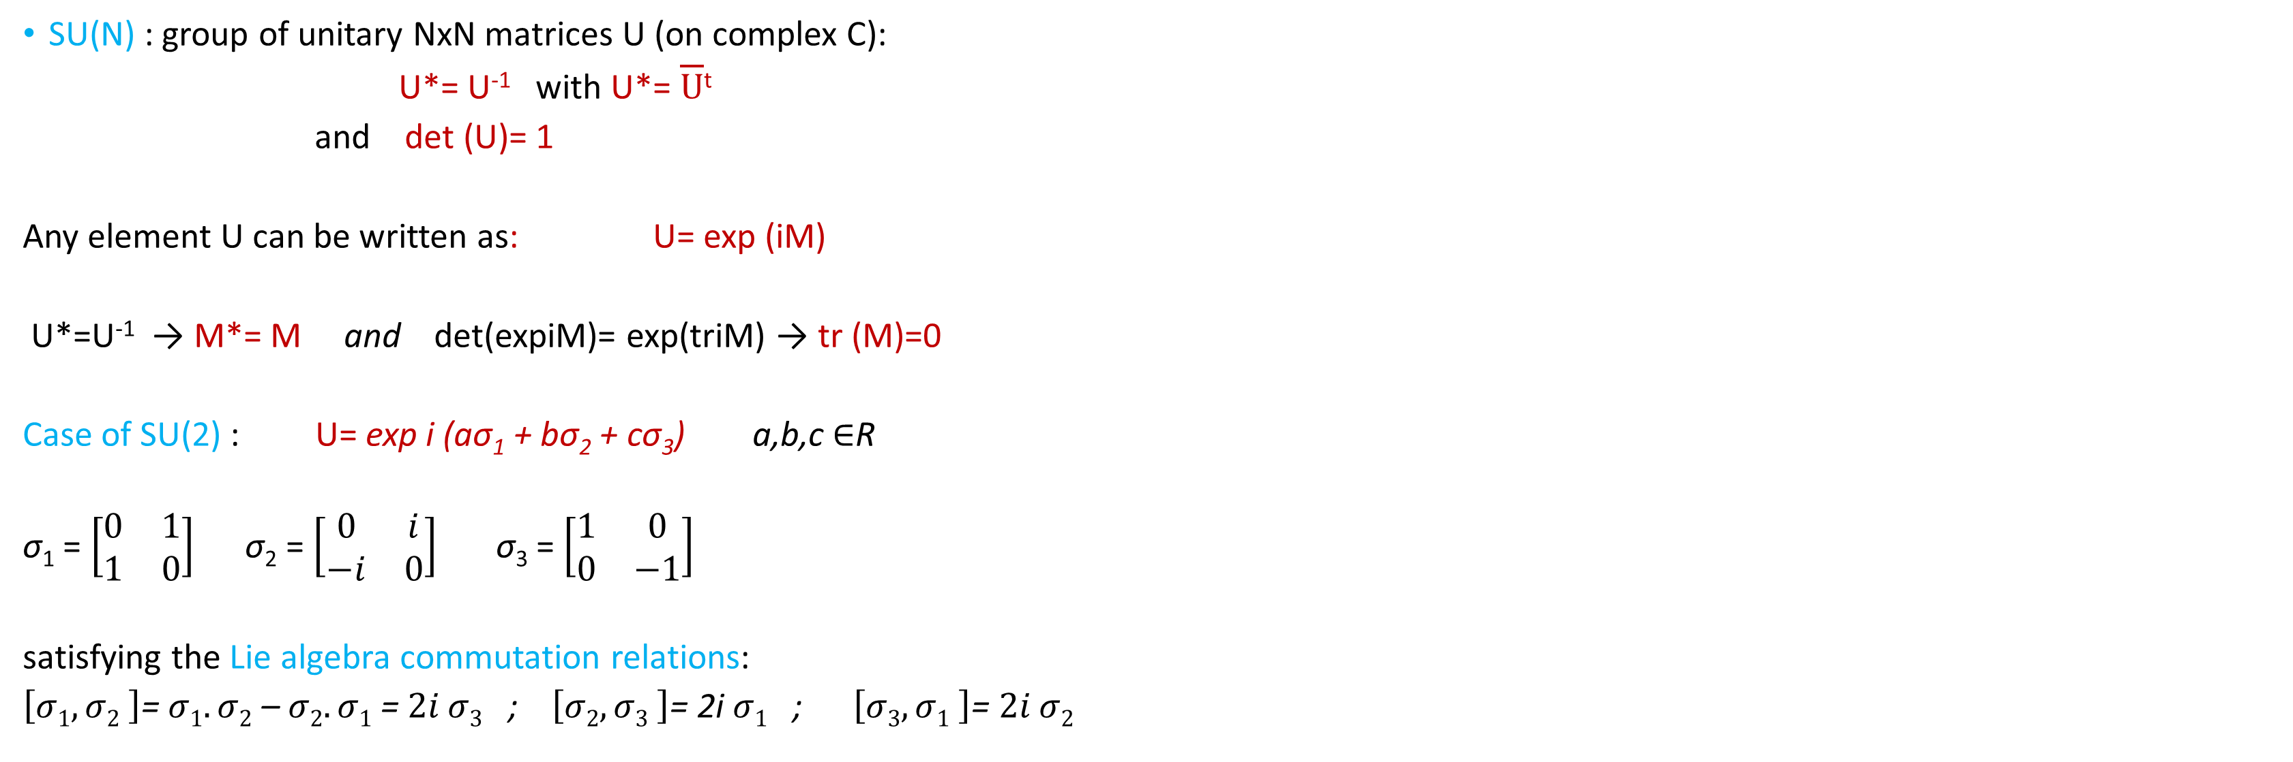
SU(N) : group of unitary NxN matrices U (on complex C):
U*= U⁻¹ with U*= $\overline{U}$^{t}
and det (U)= 1
Any element U can be written as: U= exp (iM)
U*=U⁻¹ → M*= M and det(expiM)= exp(triM) → tr (M)=0
Case of SU(2) : U= exp i (aσ₁ + bσ₂ + cσ₃) a,b,c $∈$R
σ₁ = $\left[\begin{matrix}0 & 1 \\ 1 & 0\end{matrix}\right]$ σ₂ = $\left[\begin{matrix}0 & i \\ −i & 0\end{matrix}\right]$ σ₃ = $\left[\begin{matrix}1 & 0 \\ 0 & −1\end{matrix}\right]$
satisfying the Lie algebra commutation relations:
$\left[σ1, σ2 \right]$= $σ1.σ2$ – $σ2. σ1$ = $2i σ3$ ; $\left[σ2, σ3 \right]$= 2i $σ1$ ; $\left[σ3, σ1 \right]$= $2i σ2$

Slide 16
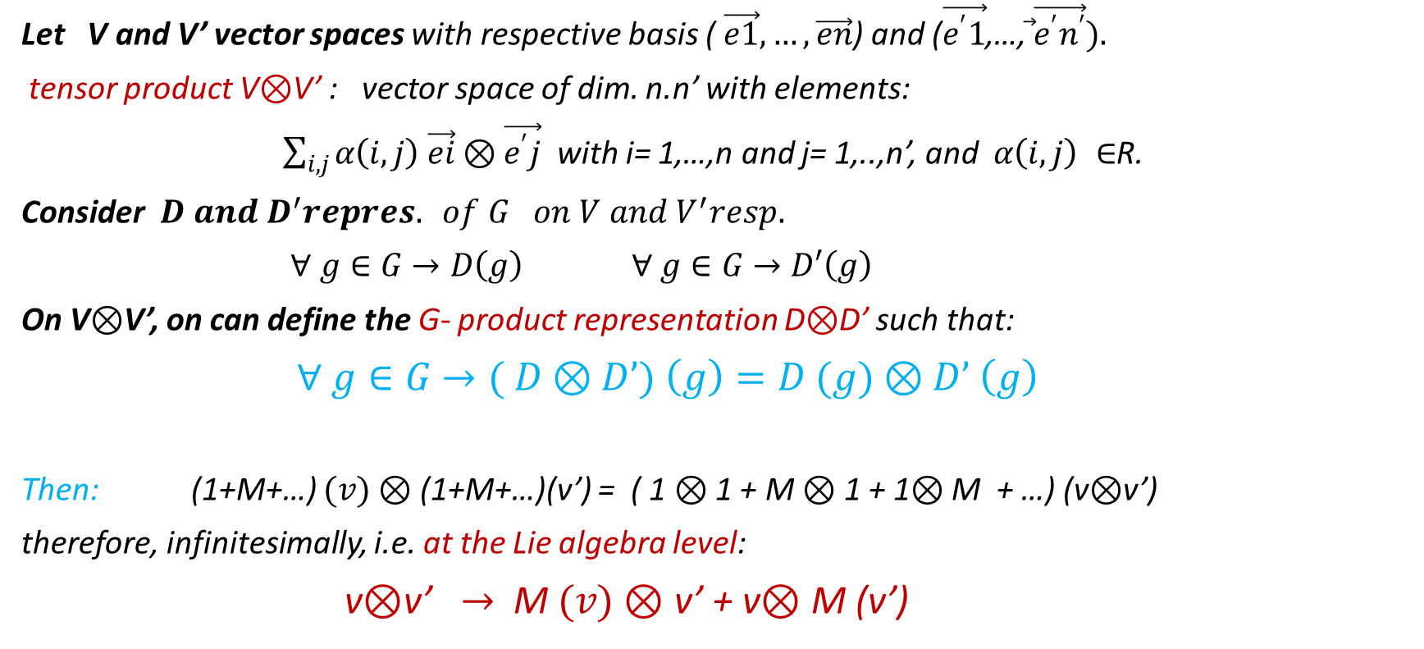
product of representations: tensorial product
Let V and V’ vector spaces with respective basis ( $\vec{e1},…, \vec{en}$) and ($\vec{e^{′}1}$,…,$\vec{ }\vec{e^{′}n^{′}}).$
tensor product V$⊗$V’ : vector space of dim. n.n’ with elements:
$\sum_{i,j}{α\left(i,j\right) \vec{ei}⊗\vec{e^{′}j}}$ with i= 1,…,n and j= 1,..,n’, and $α\left(i,j\right) ∈$R.
Consider$D and D^{′}repres. of G on V and V^{′}resp.$
$∀ g∈G→D\left(g\right)$ $∀ g∈G→D′\left(g\right)$
On V$⊗$V’, on can define the G- product representation D$⊗$D’ such that:
$∀ g∈G→( D⊗D’) \left(g\right)=D (g)⊗D’ \left(g\right)$
Then: (1+M+…) $(v)⊗$ (1+M+…)(v’) = ( 1 $⊗$ 1 + M $⊗$ 1 + 1$⊗$ M + …) (v$⊗$v’)
therefore, infinitesimally, i.e. at the Lie algebra level:
v$⊗$v’ $→$ M $(v)⊗$ v’ + v$⊗$ M (v’)

Slide 17
Example: computing the product (1/2) x(1/2) in SU(2)
(1/2) = 2dim. rep. ‘’spin1/2 ‘’ with states : (↑) and (↓)
defining σ₊ = σ₁+iσ₂, σ₋= σ₁-iσ₂ with σ₊ (↓)= (↑) and σ₋ (↑) = (↓)
We get:
σ₋ (↑.↑) = σ₋ (↑).(↑) + (↑).σ₋ (↑) = (↓.↑) + (↑.↓ )
σ₋ [ (↓.↑) + (↑.↓ )] = 2 (↓ ↓)
σ₋ (↓ ↓) = 0 providing the 3 dim. rep. of ‘’spin 1’’
while the state: [(↓.↑) - (↑.↓ )] on which σ₋ and σ₊ gives 0, is the ‘’spin0’’ rep.

Slide 18
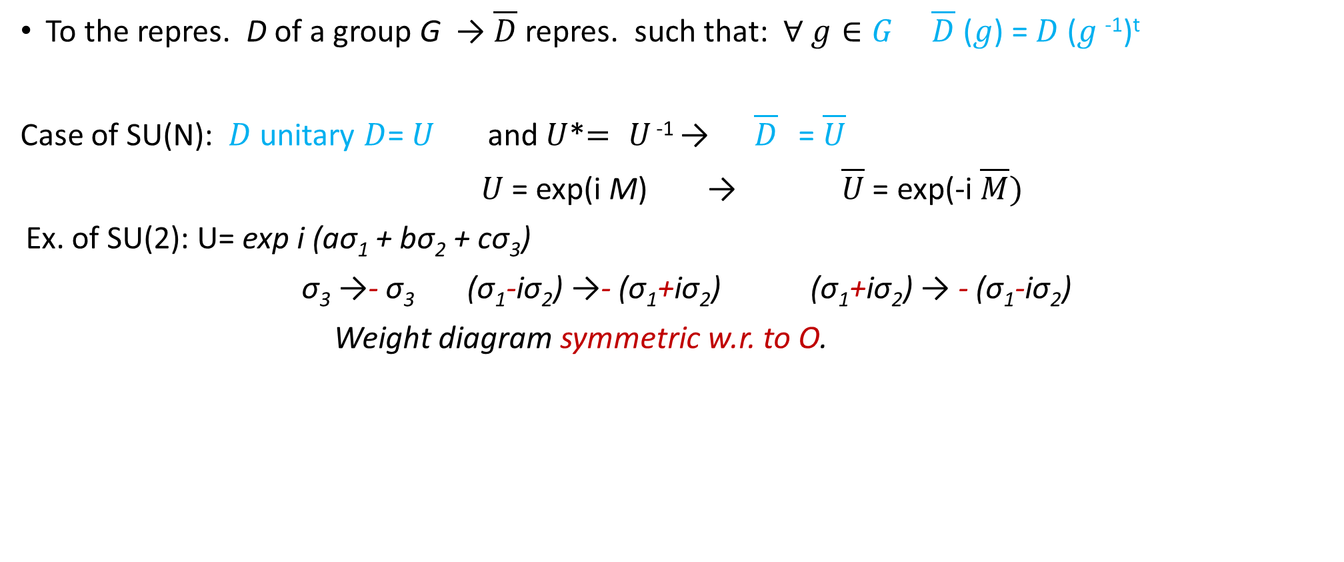
Last definition: contragredient representation:
To the repres. D of a group G → $\overline{D}$ repres. such that: $∀ g∈G$ $\overline{D}$ ($g$) = $D$ ($g$⁻¹)^{t}
Case of SU(N): $D$ unitary $D$= $U$ and $U$*$=$ $U$ ⁻¹ → $\overline{D}$ = $\overline{U}$
$U$ = exp(i M) → $\overline{U}$= exp(-i $\overline{M})$
Ex. of SU(2): U= exp i (aσ₁ + bσ₂ + cσ₃)
σ₃ →- σ₃ (σ₁-iσ₂) →- (σ₁+iσ₂) (σ₁+iσ₂) → - (σ₁-iσ₂)
Weight diagram symmetric w.r. to O.

Slide 19
3) Quarks and Flavour symmetry: a minimalist presentation
With Colour SU(3) x Spin SU(2) x Pauli principle
No need to evoke Flavour SU(N) to construct all admissible baryonic states !
( 8 states s=1/2, 10 s=3/2 for L= 0
8 states s=3/2, 10 s=1/2, 1 s=1/2 for L= 1
and so on)
H.Hogaasen and P.S. , Int.J.Mod.Phys.A23(2008)189
hep-ph/0711.3157

Slide 20
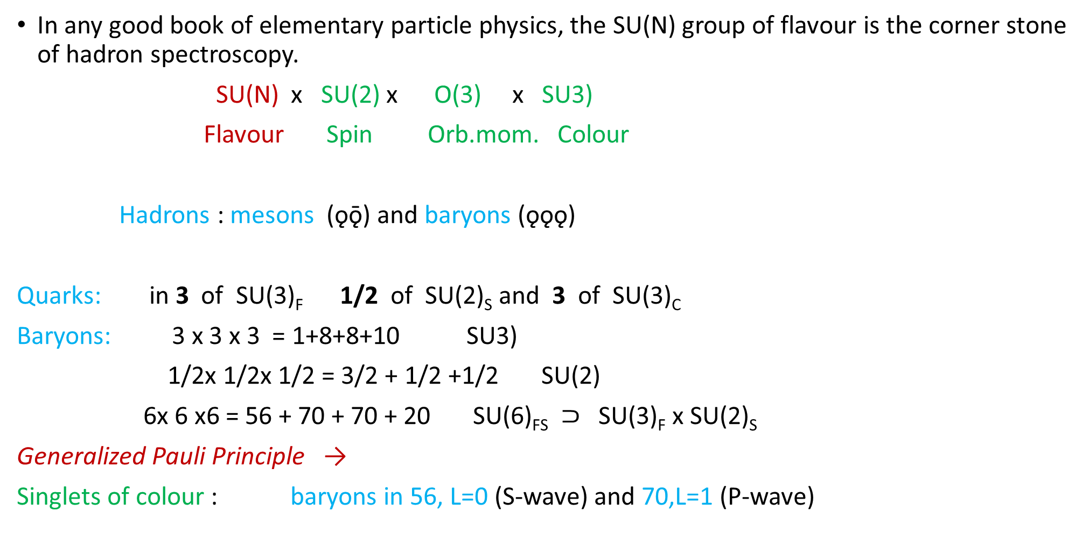
the common attitude
In any good book of elementary particle physics, the SU(N) group of flavour is the corner stone of hadron spectroscopy.
SU(N) x SU(2) x O(3) x SU3)
Flavour Spin Orb.mom. Colour
Hadrons : mesons (ǫǭ) and baryons (ǫǫǫ)
Quarks: in 3 of SU(3)_{F} 1/2 of SU(2)_{S} and 3 of SU(3)_{C}
Baryons: 3 x 3 x 3 = 1+8+8+10 SU3)
1/2x 1/2x 1/2 = 3/2 + 1/2 +1/2 SU(2)
6x 6 x6 = 56 + 70 + 70 + 20 SU(6)_{FS} $⊃$ SU(3)_{F} x SU(2)_{S}
Generalized Pauli Principle →
Singlets of colour : baryons in 56, L=0 (S-wave) and 70,L=1 (P-wave)

Slide 21
exercise: forget the flavour group and use only the (usual) Pauli Principle: what baryons can be constructed ?
S- wave states (L=0):
Ex. with 3 flavors: ǫ =u, d, s. Pauli principle
states: uuu, ddd, sss: SU(3)c singlet → wave func. symm. in SU(2)s:
(Sq=1/2) x (Sq=1/2) x (Sq=1/2) → (Sqqq=3/2)
states : uud, uus, ddu, dds, ssu, ssd: 2 and only 2 identical flav.
(Sq=1/2) x (Sq=1/2) → (Sqq=1)
It follows: (Sqq=1) x (Sq=1/2) → Sqqq= 3/2 +1/2
State: uds: 3different flav. : no Pauli princ.
(S=1/2) x (S=1/2) x (S=1/2) → (S=3/2) + (S=1/2) +(S=1/2)
Summary: Stot= 3/2 : uuu…uud…uds : 10 states → (10,4) states
Stot= 1/2 : uud (Suu=1) uds (Sud=1) uds (Sud=0) 8 states → (8,2) states
that is 56 states !

Slide 27
4) The (ǫǫǭǭ) case

Slide 28
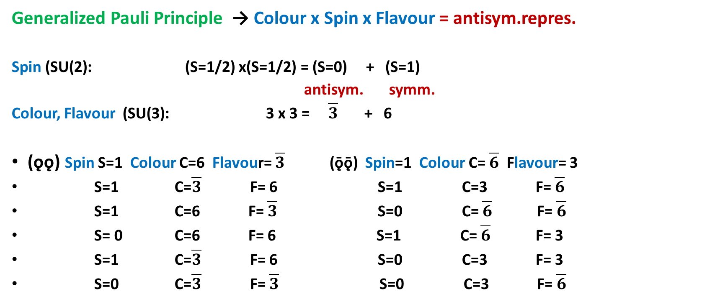
The different configurations of S=1 (ǫǫǭǭ) mesons
Generalized Pauli Principle → Colour x Spin x Flavour = antisym.repres.
Spin (SU(2): (S=1/2) x(S=1/2) = (S=0) + (S=1)
antisym. symm.
Colour, Flavour (SU(3): 3 x 3 = $\overline{3}$ + 6
(ǫǫ) Spin S=1 Colour C=6 Flavour= $\overline{3}$ (ǭǭ) Spin=1 Colour C= $\overline{6}$ Flavour= 3
S=1 C=$\overline{3}$ F= 6 S=1 C=3 F= $\overline{6}$
S=1 C=6 F= $\overline{3}$ S=0 C= $\overline{6}$ F= $\overline{6}$
S= 0 C=6 F= 6 S=1 C= $\overline{6}$ F= 3
S=1 C=$\overline{3}$ F= 6 S=0 C=3 F= 3
S=0 C=$\overline{3}$ F= $\overline{3}$ S=0 C=3 F= $\overline{6}$

Slide 29
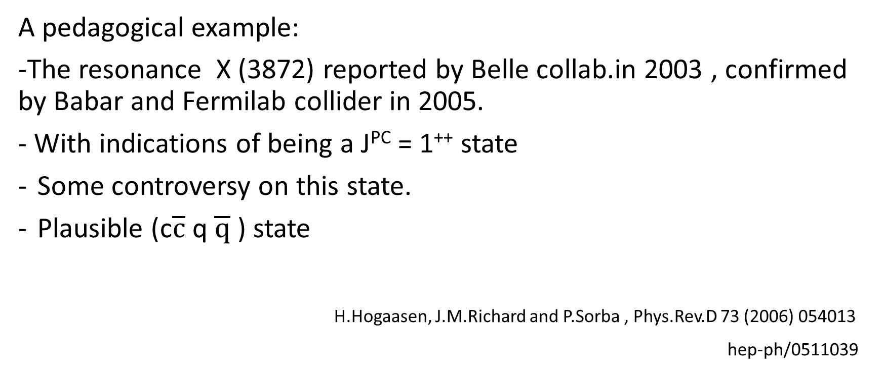
Chromomagnetic mechanism for( ǫǫǭǭ) states
A pedagogical example:
-The resonance X (3872) reported by Belle collab.in 2003 , confirmed by Babar and Fermilab collider in 2005.
- With indications of being a J^{PC} = 1⁺⁺ state
Some controversy on this state.
Plausible (c$\overline{c}$ q $\overline{q}$) state
H.Hogaasen, J.M.Richard and P.Sorba , Phys.Rev.D 73 (2006) 054013
hep-ph/0511039

Slide 30
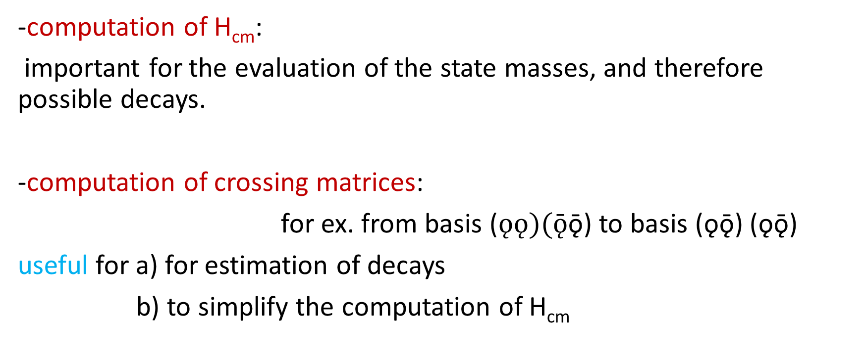
algebraic computations
-computation of H_{cm}:
important for the evaluation of the state masses, and therefore possible decays.
-computation of crossing matrices:
for ex. from basis ($ǫǫ)(ǭ$ǭ) to basis (ǫǭ) (ǫǭ)
useful for a) for estimation of decays
b) to simplify the computation of H_{cm}

Slide 31
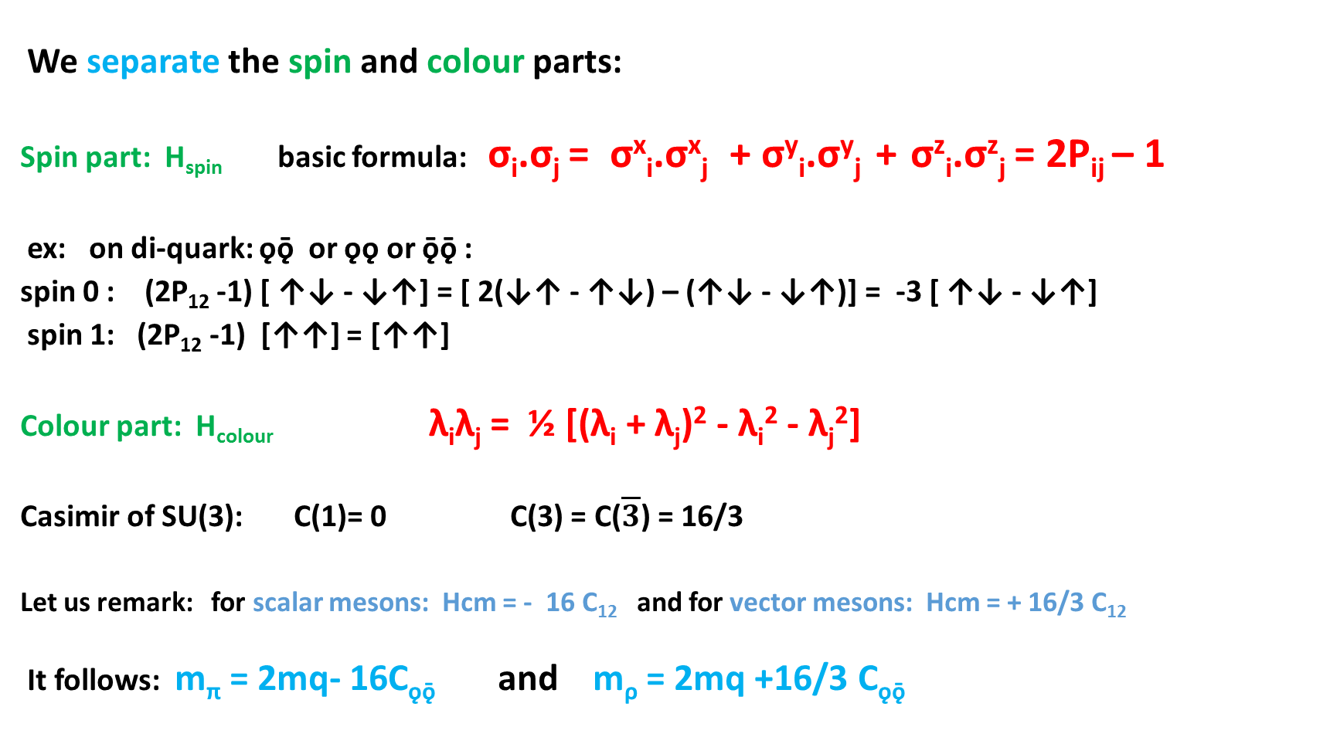
Method of computation of H_{cm}= - Σ C_{ij} λ_{i}λ_{j}σ_{i}σ_{j}
We separate the spin and colour parts:
Spin part: H_{spin} basic formula: σ_{i}.σ_{j} = σ^{x}_{i}.σ^{x}_{j} + σ^{y}_{i}.σ^{y}_{j} + σ^{z}_{i}.σ^{z}_{j} = 2P_{ij} – 1
ex: on di-quark: ǫǭ or ǫǫ or ǭǭ :
spin 0 : (2P₁₂ -1) [ ↑↓ - ↓↑] = [ 2(↓↑ - ↑↓) – (↑↓ - ↓↑)] = -3 [ ↑↓ - ↓↑]
spin 1: (2P₁₂ -1) [↑↑] = [↑↑]
Colour part: H_{colour} λ_{i}λ_{j} = ½ [(λ_{i} + λ_{j})² - λ_{i}² - λ_{j}²]
Casimir of SU(3): C(1)= 0 C(3) = C($\overline{3}$) = 16/3
Let us remark: for scalar mesons: Hcm = - 16 C₁₂ and for vector mesons: Hcm = + 16/3 C₁₂
It follows: m_{π} = 2mq- 16C_{ǫǭ} and m_{ρ} = 2mq +16/3 C_{ǫǭ}

Slide 32
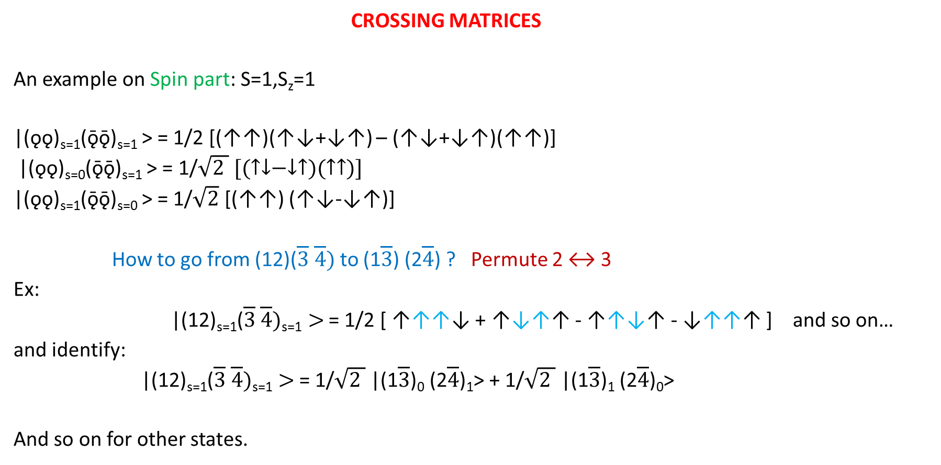
How to go from (ǫǫ) (ǭǭ) basis to (ǫǭ) (ǫǭ) basis ?
CROSSING MATRICES
An example on Spin part: S=1,S_{z}=1
|(ǫǫ)_{s=1}(ǭǭ)_{s=1} > = 1/2 [(↑↑)(↑↓+↓↑) – (↑↓+↓↑)(↑↑)]
|(ǫǫ)_{s=0}(ǭǭ)_{s=1} > = 1/$\sqrt{2 } [(↑↓−↓↑)(↑↑)]$
|(ǫǫ)_{s=1}(ǭǭ)_{s=0} > = 1/$\sqrt{2}$ [(↑↑) (↑↓-↓↑)]
How to go from (12)($\overline{3} \overline{4})$to (1$\overline{3}$) (2$\overline{4}$) ? Permute 2 ↔ 3
Ex:
|(12)_{s=1}($\overline{3} \overline{4})\text{s}\text{=1}>$ = 1/2 [ ↑↑↑↓ + ↑↓↑↑ - ↑↑↓↑ - ↓↑↑↑ ] and so on…
and identify:
|(12)_{s=1}($\overline{3} \overline{4})\text{s}\text{=1}>$ = 1/$\sqrt{2 }$ |(1$\overline{3}$)₀ (2$\overline{4}$)₁> + 1/$\sqrt{2 }$ |(1$\overline{3}$)₁ (2$\overline{4}$)₀>
And so on for other states.

Slide 33
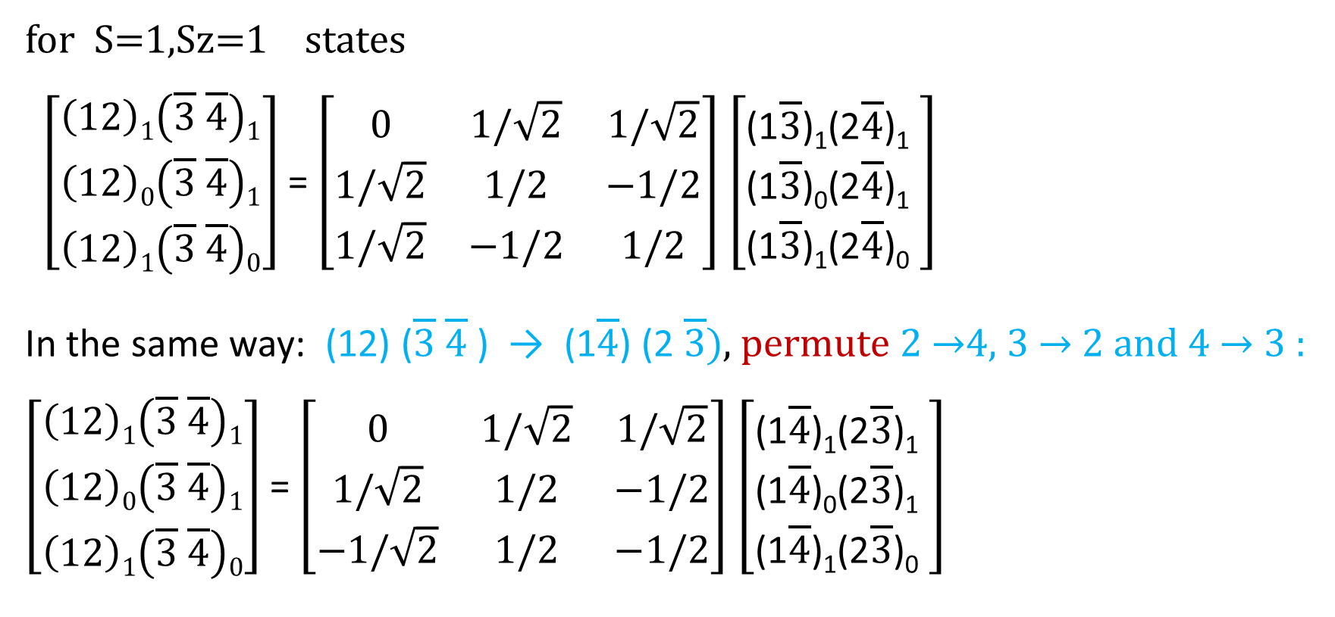
Spin Crossing Matrices
for S=1,Sz=1 states
$\left[\begin{aligned}\left(12\right)1\left(\overline{3} \overline{4}\right)1 \\ \left(12\right)0\left(\overline{3} \overline{4}\right)1 \\ \left(12\right)1\left(\overline{3} \overline{4}\right)0\end{aligned}\right]$= $\left[\begin{matrix}0 & 1/\sqrt{2} & 1/\sqrt{2} \\ 1/\sqrt{2} & 1/2 & −1/2 \\ 1/\sqrt{2} & −1/2 & 1/2\end{matrix}\right]$ $\left[\begin{aligned}\text{(1}\overline{3}\text{)}\text{1}\text{(2}\overline{4}\text{)}\text{1} \\ \text{(1}\overline{3}\text{)}\text{0}\text{(2}\overline{4}\text{)}\text{1} \\ \text{(1}\overline{3}\text{)}\text{1}\text{(2}\overline{4}\text{)}\text{0} \end{aligned}\right]$
In the same way: (12) ($\overline{3} \overline{4}$ ) → (1$\overline{4}$) (2 $\overline{3})$, permute 2 →4, 3 → 2 and 4 → 3 :
$\left[\begin{aligned}\left(12\right)1\left(\overline{3} \overline{4}\right)1 \\ \left(12\right)0\left(\overline{3} \overline{4}\right)1 \\ \left(12\right)1\left(\overline{3} \overline{4}\right)0\end{aligned}\right]$= $\left[\begin{matrix}0 & 1/\sqrt{2} & 1/\sqrt{2} \\ 1/\sqrt{2} & 1/2 & −1/2 \\ −1/\sqrt{2} & 1/2 & −1/2\end{matrix}\right]$ $\left[\begin{aligned}\text{(1}\overline{4}\text{)}\text{1}\text{(2}\overline{3}\text{)}\text{1} \\ \text{(1}\overline{4}\text{)}\text{0}\text{(2}\overline{3}\text{)}\text{1} \\ \text{(1}\overline{4}\text{)}\text{1}\text{(2}\overline{3}\text{)}\text{0} \end{aligned}\right]$

Slide 37
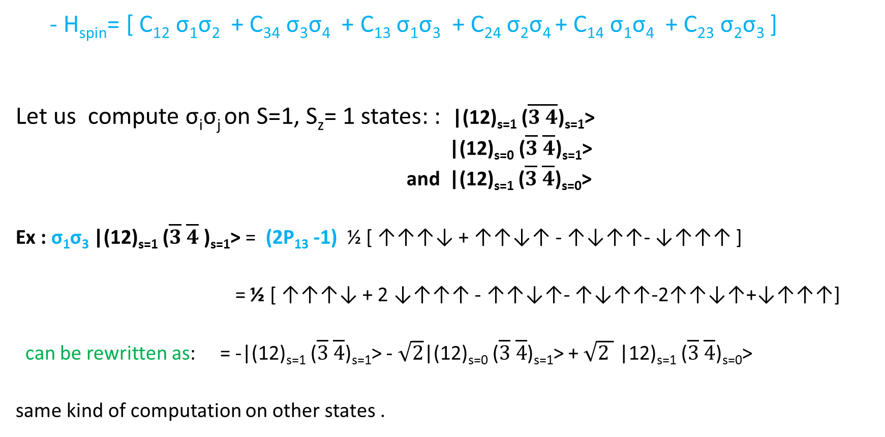
H_{cm} on (ǫǫǭǭ) states
- H_{spin}= [ C₁₂ σ₁σ₂ + C₃₄ σ₃σ₄ + C₁₃ σ₁σ₃ + C₂₄ σ₂σ₄ + C₁₄ σ₁σ₄ + C₂₃ σ₂σ₃ ]
Let us compute σ_{i}σ_{j} on S=1, S_{z}= 1 states: : |(12)_{s=1} ($\overline{3 }\overline{4}$)_{s=1}>
|(12)_{s=0} ($\overline{3} \overline{4}$)_{s=1}>
and |(12)_{s=1} ($\overline{3} \overline{4}$)_{s=0}>
Ex : σ₁σ₃ |(12)_{s=1} ($\overline{3} \overline{4}$)_{s=1}> = (2P₁₃ -1) ½ [ ↑↑↑↓ + ↑↑↓↑ - ↑↓↑↑- ↓↑↑↑ ]
= ½ [ ↑↑↑↓ + 2 ↓↑↑↑ - ↑↑↓↑- ↑↓↑↑-2↑↑↓↑+↓↑↑↑]
can be rewritten as: = -|(12)_{s=1} ($\overline{3} \overline{4}$)_{s=1}> - $\sqrt{2}$|(12)_{s=0} ($\overline{3} \overline{4}$)_{s=1}> + $\sqrt{2 }$ |12)_{s=1} ($\overline{3} \overline{4}$)_{s=0}>
same kind of computation on other states .

Slide 38
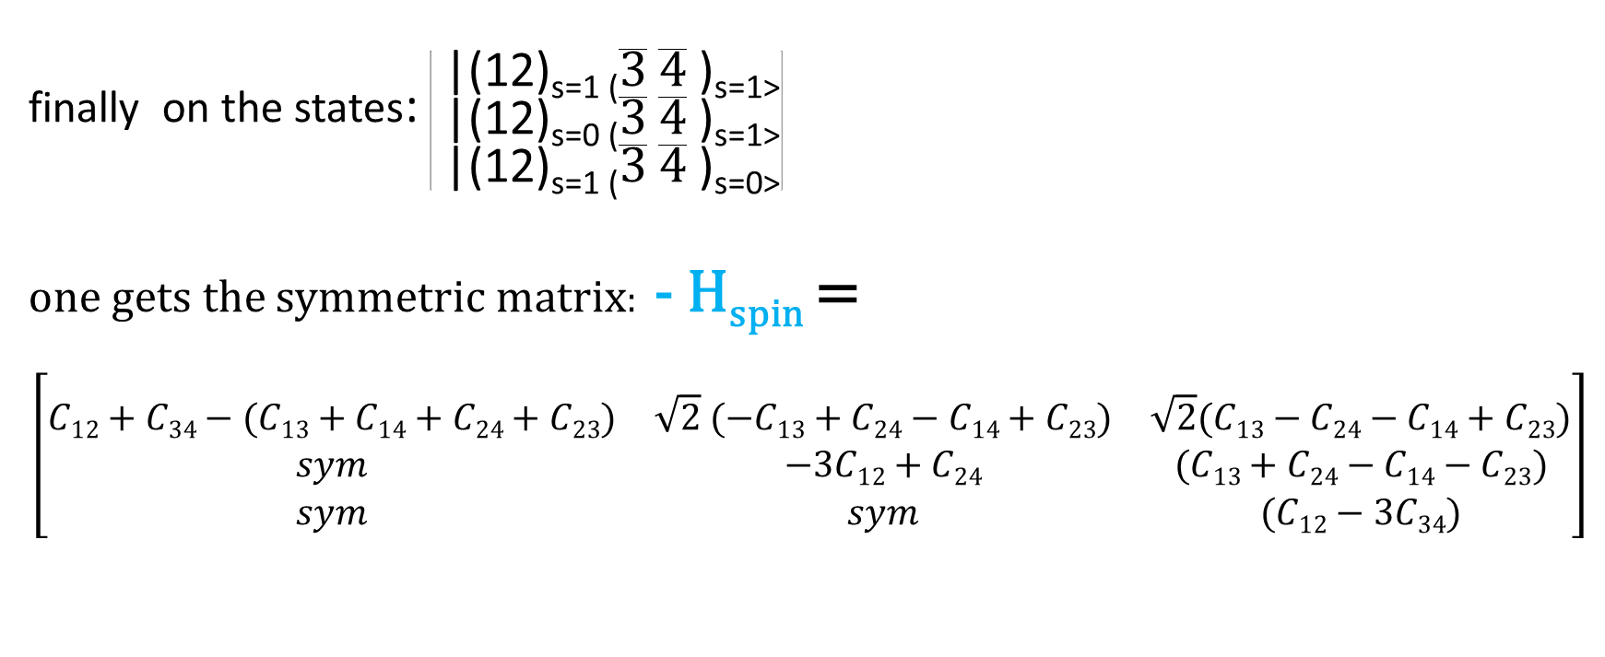
finally on the states: $\left[\begin{aligned}\text{ |(12)}\text{s}\text{=1 (}\overline{3} \overline{4} \text{)}\text{s}\text{=1>} \\ \text{ |(12)}\text{s}\text{=0 (}\overline{3} \overline{4} \text{)}\text{s}\text{=1>} \\ \text{ |(12)}\text{s}\text{=1 (}\overline{3} \overline{4} \text{)}\text{s}\text{=0>}\end{aligned}\right]$
one gets the symmetric matrix: - H_{spin} =
$$\left[\begin{aligned} \\ \begin{matrix}C12+C34−(C13+C14+C24+C23) & \sqrt{2} (−C13+C24−C14+C23) & \sqrt{2}(C13−C24−C14+C23) \\ sym & −3C12+C24 & (C13+C24−C14−C23) \\ sym & sym & (C12−3C34)\end{matrix}\end{aligned}\right]$$

Slide 39
in the same way: - H_{colour}
- H_{colour}= [C₁₂ λ₁λ₂ + C₃₄ λ₃λ₄ + C₁₃ λ₁λ₃ + C₂₄ λ₂λ₄ +C₁₄ λ₁λ₄ + C₁₃ λ₁λ₃]
with: λ_{i}λ_{j} = ½ [(λ_{i} + λ_{j})² - λ_{i}² - λ_{j}²]
and using the Casimir values: C(3)= 16/3, C(6)= 40/3, C(8)= 12
and C(1)= 0, one gets the values: λi λj =4/3 if ( λ_{i}+λ_{j}) = repres. 6
= -8/3 3
= 2/3 8
=-16/3 1

Slide 41
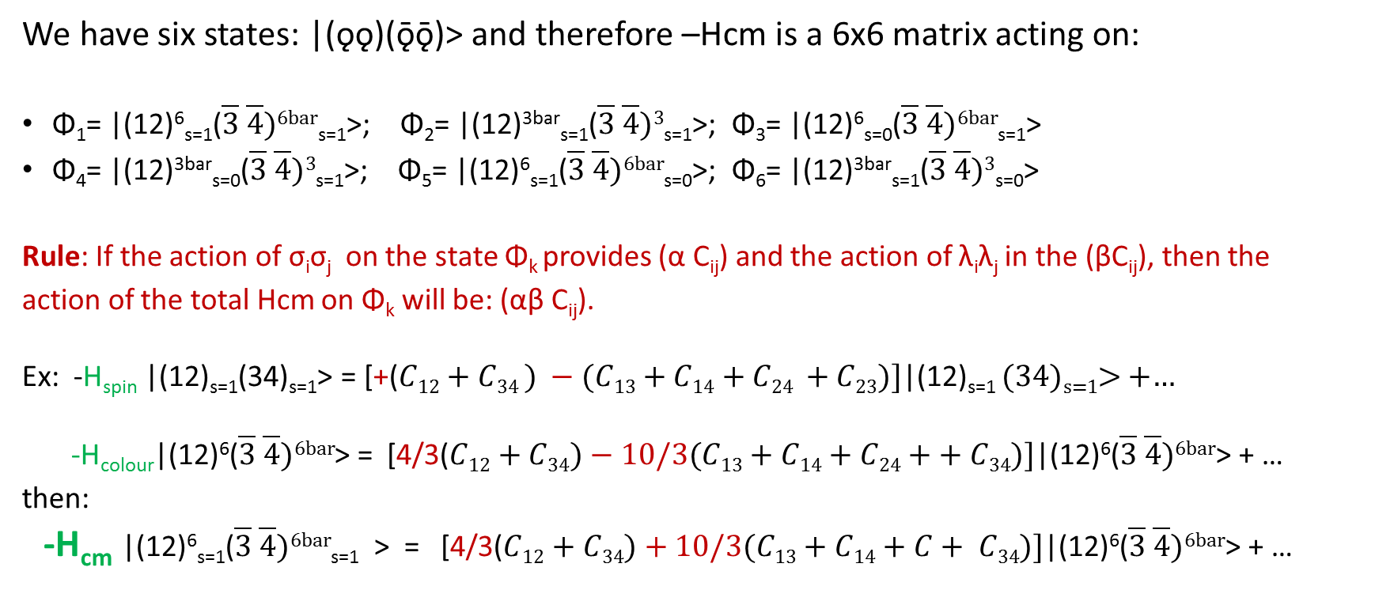
Performing tensorial product of H_{spin} and H_{colour}
We have six states: |(ǫǫ)(ǭǭ)> and therefore –Hcm is a 6x6 matrix acting on:
Φ₁= |(12)⁶_{s=1}($\overline{3} \overline{4})6bar$_{s=1}>; Φ₂= |(12)^{3bar}_{s=1}($\overline{3} \overline{4})3$_{s=1}>; Φ₃= |(12)⁶_{s=0}($\overline{3} \overline{4})6bar$_{s=1}>
Φ₄= |(12)^{3bar}_{s=0}($\overline{3} \overline{4})3$_{s=1}>; Φ₅= |(12)⁶_{s=1}($\overline{3} \overline{4})6bar$_{s=0}>; Φ₆= |(12)^{3bar}_{s=1}($\overline{3} \overline{4})3$_{s=0}>
Rule: If the action of σ_{i}σ_{j} on the state Φ_{k} provides (α C_{ij}) and the action of λ_{i}λ_{j} in the (βC_{ij}), then the
action of the total Hcm on Φ_{k} will be: (αβ C_{ij}).
Ex: -H_{spin} |(12)_{s=1}(34)_{s=1}> = [+($C12+C34 ) −(C13+C14+C24 +C23)]\text{|(12)}\text{s}\text{=1 }$(34)_{s=1}> +…
-H_{colour}|(12)⁶($\overline{3} \overline{4})6bar$> = [4/3($C12+C34)−10/3(C13+C14+C24++ C34)]\text{|(12)}\text{6}\text{(}\overline{3} \overline{4})6bar\text{> + …}$
then:
-H_{cm} |(12)⁶_{s=1}($\overline{3} \overline{4})6bar$_{s=1} > = [4/3($C12+C34)+10/3(C13+C14+C+ C34)]\text{|(12)}\text{6}\text{(}\overline{3} \overline{4})6bar\text{>}$ + …

Slide 42
Coming back to our state X(3872) supposed made of charm-anticharm and two light quarks.

Slide 45
5) The ǫǫǫǫǭ case (On the discrete charm of pentaquarks)

Slide 46
The Pentaquark along the years: A game of hide and seek…
at Cern Bubble Chamber,
1978: ACNO Collab. found a Y*(2,58) decaying into 3 strange particles
1979: BCGMP Collab. found from Kp two states R(3,17) and Ξ*(2,37) decaying into strange part.; longer lifetime than usual baryons. R(3,17); confirmed in Argonne.
toward an octet of pentaquarks?
then no more signal…
2003: Photon Nucleus LEPS Collab,
Kaon Nucleus DIANA Collab,
Photon Deuteron CLAS Collab,
Photon Proton Collab. SAPHYR found a narrow Θ+(1540)= Θ(uuddsbar)
2004: NA49 Collab. Ξ⁻⁻(1872) and Ξ⁰, width 18 Mev
then no more signal…at WA89, Belle, BaBar

Slide 47
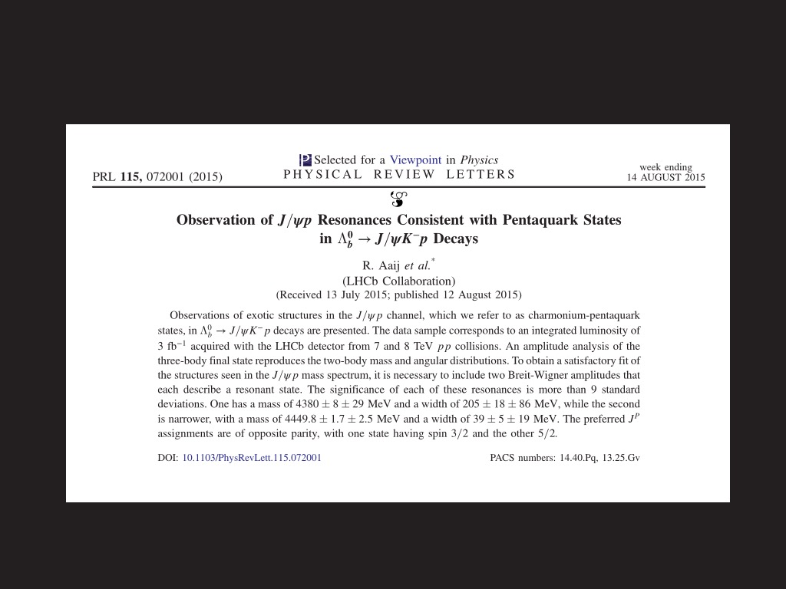
3) LHCb discovery

Slide 48
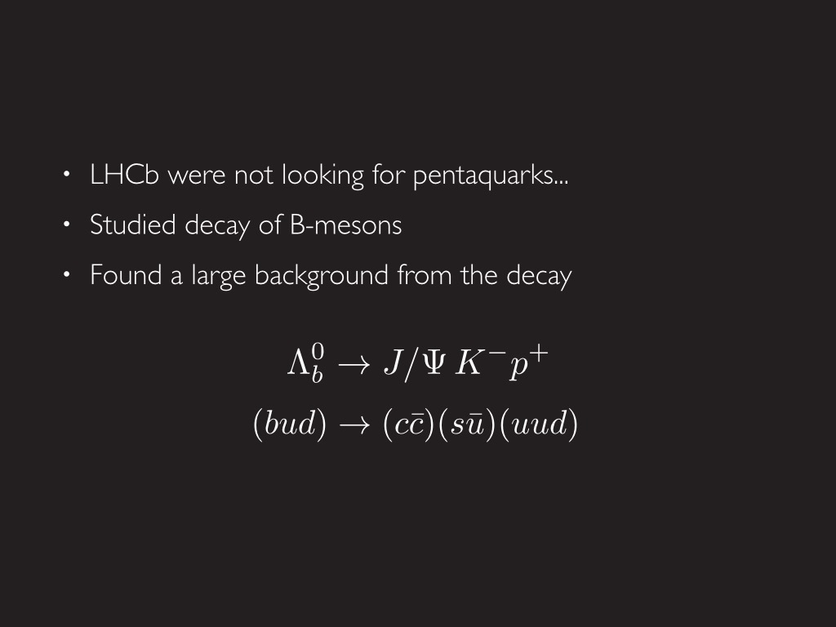

Slide 49
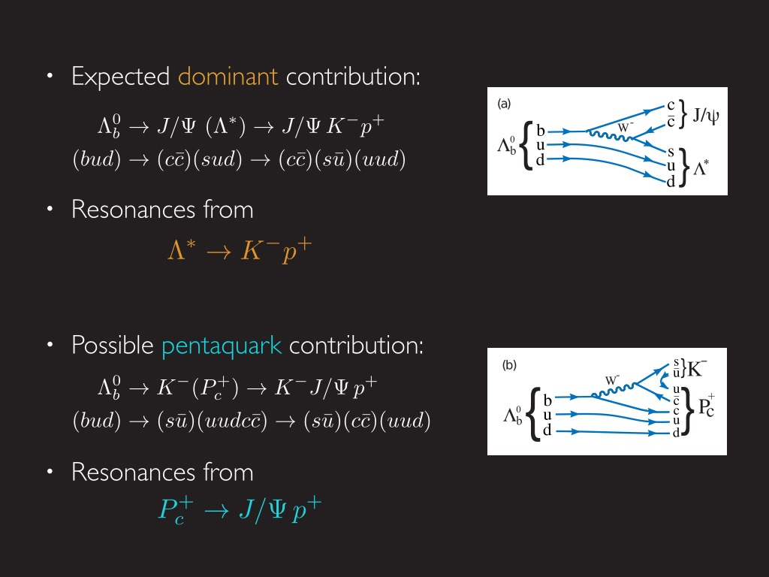
Courtesy of Anders Kvellestad

Slide 50
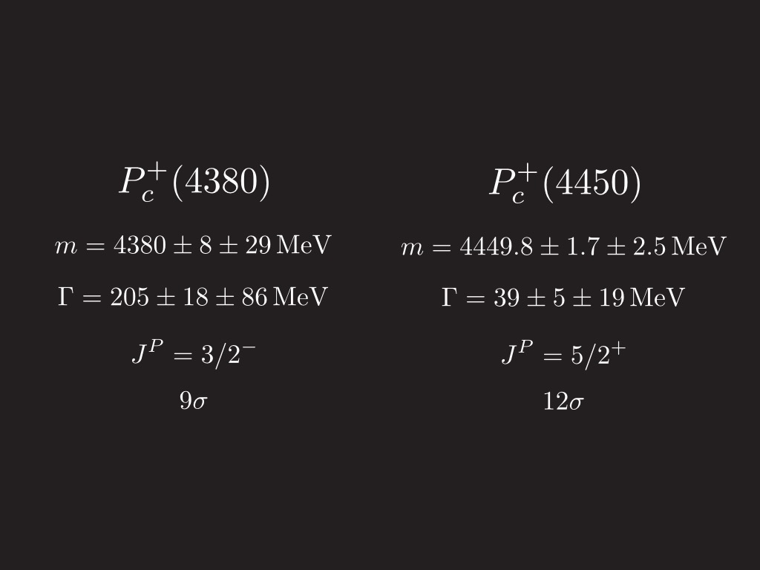
(3/2⁺)
(5/2⁻)

Slide 51
Pentaquark, favorite configurations with L non zero
ǫǫǫǫ---L---ǭ or ǫǫǫǭ---L---ǫ : not good : ‘’easy decay’’ after pair creation
c= 3 x c=3bar c=3bar x c=3
ǫǫǭ---L---ǫǫ :
c=3 x c=3bar : not good : 3x(1+8) ---3bar : the (1x3=3) ---3bar will ‘’go out’’
c=6bar x c= 6 : VERY Interesting
ǫǫǫ---L---ǫǭ
c=1x c=1 : not interesting
c=8 xc=8 : Interesting, but by adding a gluon each cluster can become a singlet…

Slide 52
4 a) a way to get the two states Pc(4380) and Pc(4450)
First, compute: (H.Hogaasen and P.S. ,1978 and 2005, and now)
-Hcm -Hcm -Hcm
(qqq ) s=1/2 (uud) -40 Mev (qqcbar) s=1/2 (uucbar) +67 Mev (qqbar) s =0 (ccbar) +8Mev
+200 Mev (udcbar) + 67Mev
c=8 (uuc) -168 Mev c=6bar - 160 Mev c=8 (ucbar) or (dcbar) +10 Mev
-52 Mev
(udc) -168 Mev (uccbar) or (dccbar) - 40 Mev
-52 Mev +26 Mev s=1 (ccbar) -3 Mev
+102 Mev
+38 Mev (ucbar) or (dcbar) -3 Mev
s=3/2 (uud) +40 mev s=3/2 (udcbar) -47 Mev
(uuc) +50 Mev (qq) s=0 (uc) or (dc) +20 Mev
(udc) -10 Mev (uccbar) or (udcbar) -7Mev
+50 Mev c=6 s=1 (uc) or (dc) -7Mev
With Cuu=Cud= 25 Mev, Cuc=Cdc= 5 mev, Cccbar= 4 Mev from usual hadrons

Slide 53
Then, considering:
(uucbar) ----L=1---(dc) (uucbar)---L=2---(dc)
(c = 6bar) x (c=6)
s=1/2 s=0 s=1/2 s=1
-Hcm = +67+ 20 =87 Mev -Hcm= -160-7=- 167 Mev
with: mu=md= 323 Mev, mc= mcbar= 1500 Mev
∆ (L)= 323Mev (reasonable estimates)
we get for M(Pc) =4380 Mev and 4450 Mev, with spin (3/2) and (5/2) and parity + and – respectively

Slide 54
4b) are multiquark states more stable with heavy quarks?
↗Rk 1: the values of Hcm important:
let pentaquark P with possible decay into meson M and baryon B , it seems
m(M) +m(B) increases w.r.to m(P) with the presence of an heavy quark,
so preventing the decay of P.
(J.M.Richard et al, 1987)L
Rk2: Consider 2 quarks in a cluster:
If the two quarks are light, the reduced mass:
1/m = 1/m(l) + 1/m(l) = 2/m(l)
while if one quark is light and the other is heavy :
1/m = 1/m(l) + 1/m(h) ≈1/m(l) , that is smaller
Since r(Bohr) is proportional to 1/m, r(Bohr) is smaller when there is an heavy quark , and this cluster will have less chance to overlap with the other one.

Slide 55
We just landed…
Thank you for your attention

